Slide 1
School Drop-off/Pick-up Model
ActivitySim Consortium Meeting
March 8, 2022

Slide 2
School Drop-off/Pick-up Model
Used to link drivers (chauffeurs) with children who go to school (escortees)
Chauffeurs and escortees linked by direction
Outbound (drop-off)
Inbound (pick-up)
Escort type
Pure: Tour purpose of driver = escort
Ride-share: Tour purpose of driver = work\school
“Bundles”
A driver, with one or more children, by direction, and purpose
Forms tours explicitly

Slide 3
How much travel are we talking about?
2016-17 SANDAG household survey:
24% percent of shared ride trips were for part of a tour involving a drop-off or pick-up of a child at school.
18% of share-ride trips were made by members of a fully joint tour (where all members travel together)

Slide 4
School Drop-off/Pick-up Model Origin Story
Vovsha, P. , and Petersen, E. Escorting Children to School: Statistical Analysis and Applied Modeling Approach. In Transportation Research Record: Journal of the Transportation Research Board, No. 1921, 2005, pp. 131–140.
Gupta, S. Vovsha, P, Livshits, V., Maneva, P., and Jeon, K. Incorporation of Escorting Children to School in Modeling Individual Daily Activity Patterns of Household Members, In Transportation Research Record: Journal of the Transportation Research Board, No. 2429, 2014, pp. 20-29.
Basic design implemented in multiple ABMs
TourCast for H-GAC, BMC, MetCouncil
CT-RAMP for MAG, Ohio MPOs, JTMT, SANDAG, Southern Oregon, Oregon Metro

Slide 5
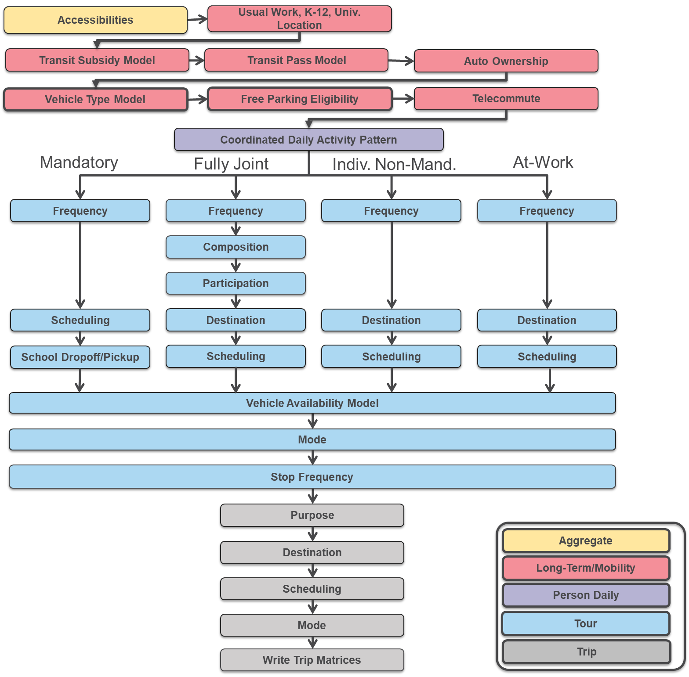

Slide 6
One-Direction Need & Bundling Choice Tree (15 alts)
1,2,3
1+2+3
1+2 / 3
1,2
1+2
1,3
2,3
1
2
3
3
No
2
1
2+3
2/3
1+3
1/3
1/2
1+3 / 2
2+3 / 1
1/2/3
Outbound
Need
Bundling
1 Bundle
2 Bundles
3 Bundles
Child 1
Child 2
Child 3

Slide 7
Driver Assignment and Escort Type
Assignment of 2 bundles to drivers
Alternative | Driver 1 | Driver 2
1 | 1 & 2 | none
2 | none | 1 & 2
3 | 1 | 2
4 | 2 | 1
Bundle
Driver 1
Driver 2
Ridesharing
Pure escort
Pure escort
Ridesharing
Tour type alternatives for each assignment
Alternative | Driver 1 | Driver 2
1 | 4
2 |  | 4
3 | 2 | 2
4 | 2 | 2
Escort stop on Mandatory Tour
16 total driver/escort type alternatives for each of the 6 alternatives on previous slide with 2 bundles
Escort stop with or without other Non-Mandatory
Notes:
Ridesharing means escort activity on way to work or school (mandatory activity)
Pure escort means escort activity without any mandatory activity (but possibly with non-mandatory activity)

Slide 8
Total Alternatives (per direction)
173 total alternatives
1 no escorting
+ 7 alternatives with 1 bundle * 2 drivers * 2 escort types
+ 6 alternatives with 2 bundles * 16 (driver/escort type combinations)
+ 1 alternative with 3 bundles * 48 (driver/escort type combinations)
Total 1 + 7 * 2 * 2 + 6 * 16 + 1 * 48 = 173
Model is run sequentially
First outbound
Then inbound
Then outbound again!

Slide 9
Availability rules
School age children with a school tour
Driving age adults with an active (M or N) pattern
Ride-share escort tour turned off for driver if no work or school tour
Ride-share escort tour turned off for driver in outbound direction if departure time is not within 30 minutes of student departure time
Ride-share escort tour turned off for driver in inbound direction if arrival time is not within 30 minutes of student arrival time

Slide 10
Explanatory variables
Driver disutility for ridesharing
Out-of-direction distance, time, income, autos-workers ratio, gender, person type
Escortee utility for ridesharing
Age
Escortee utility for non-rideshare
Non-motorized time to school
Bundling utilities (driving each child separately versus taking together)
Proximity of school locations to each other, whether same zone for school locations
Tours are formed from model results
Children dropped off in order from closest stop to furthest stop.
Children picked up in order from furthest child to closest child.

Slide 11
Implementation
Alternatives file lists all combinations of different dimensions – bundling children, assignment to driver, escort tour type
Many complicated variables
Need to figure out which ones can be calculated in pre-processor
Current model very auto-focused (how does transit access affect utility? How would AVs affect utility?)
Tour formation code
Requires flexible number of tours first?

Slide 12

Questions/Discussion

Slide 13
Joel Freedman
Senior Director
Joel.Freedman@rsginc.com

Slide 14
Accessibilities
Usual Work, K-12, Univ. Location
Transit Subsidy Model
Transit Pass Model
Auto Ownership
Vehicle Type Model
Free Parking Eligibility
Telecommute
Coordinated Daily Activity Pattern
Mandatory
Fully Joint
Indiv. Non-Mand.
At-Work
Frequency
Frequency
Frequency
Frequency
Composition
Participation
Scheduling
Destination
Destination
Destination
School Dropoff/Pickup
Scheduling
Scheduling
Scheduling
Vehicle Availability Model
Mode
Stop Frequency
Purpose
Aggregate
Destination
Long-Term/Mobility
Scheduling
Person Daily
Mode
Tour
Write Trip Matrices
Trip

