Slide 1
Shadow pricing
ActivitySim Consortium Meeting
March 29, 2022

Slide 2
Outline
What are shadow prices in destination choice?
How are they calculated in ActivitySim?
Proposed ActivitySim enhancements

Slide 3
Shadow prices

Slide 4
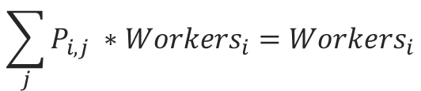
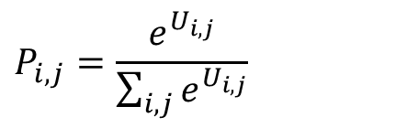
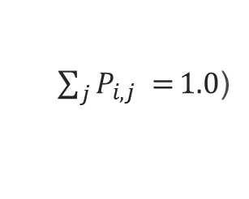
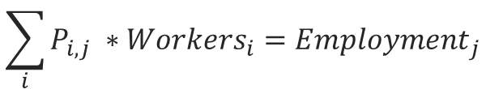
Shadow pricing
In destination choice, the shadow price is a constant that is added to each destination alternative in order to ‘doubly constrain’ the model.
A doubly constrained work location choice model is one in which the output of the model matches both origin constraints (workers) and destination constraints (employment)
Compensates for market competition
$$P_{i,j}=\frac{e^{U_{i,j}}}{\sum_{i,j}{e^{U_{i,j}}}}$$
Origin constraint:
$$\sum_{j}{P_{i,j} ∗{Workers}_{i}={Workers}_{i}}$$
(given, because
$\sum_{j}{P_{i,j} =}1.0$)
Destination constraint:
$$\sum_{i}{P_{i,j} ∗{Workers}_{i}={Employment}_{j}}$$
(requires shadow price)

Slide 5
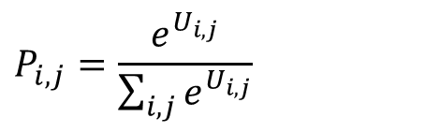
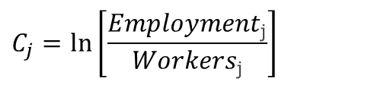
Calculation of shadow prices
Shadow prices are calculated in one of two ways
  Additional alternative-specific constant for each destination zone
  Multiplier on size term
$$P_{i,j}=\frac{e^{U_{i,j}}}{\sum_{i,j}{e^{U_{i,j}}}}$$
Sample Utility Equation:
U_{j} = β_{logsum} * logsum_{ij} + β_{dist} * dist_{ij}
+ ln(retail_emp_{j} + θ_{service_emp} * service_emp_{j})
+ C_{j}
(quality variables)
(quantity variable - size)
(shadow price)
where:
$$C_{j}=\ln\left[\frac{Employment\text{j}}{Workers\text{j}}\right]$$
(requires iteration)

Slide 6
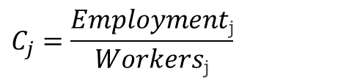
Calculation of shadow prices
Shadow prices are calculated in one of two ways
  Additional alternative-specific constant for each destination zone
  Multiplier on size term
$$P_{i,j}=\frac{e^{U_{i,j}}}{\sum_{i,j}{e^{U_{i,j}}}}$$
Sample Utility Equation:
U_{j} = β_{logsum} * logsum_{ij} + β_{dist} * dist_{ij}
+ ln(retail_emp_{j} + θ_{service_emp} * service_emp_{j})
* C_{j}
(quality variables)
(quantity variable - size)
(shadow price)
where:
$$C_{j}=\frac{Employment\text{j}}{Workers\text{j}}$$
(requires iteration)

Slide 7
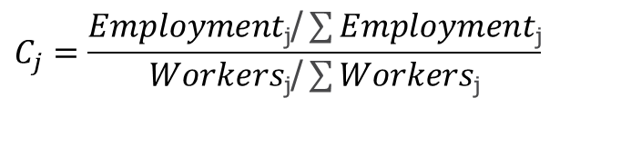
Calculation of shadow prices
Total workers typically not equal to total employment
  In and out-commuting
  Workers who work more than one job
  Differences in sources of data
    Worker totals from 5-year ACS
    Employment totals often count all jobs in a given year
Therefore, scaling is used:
$$C_{j}=\frac{Employment\text{j}\text{/}\sum{Employment\text{j}}}{Workers\text{j}\text{/}\sum{Workers\text{j}}}$$

Slide 8
Shadow prices in ActivitySim

Slide 9
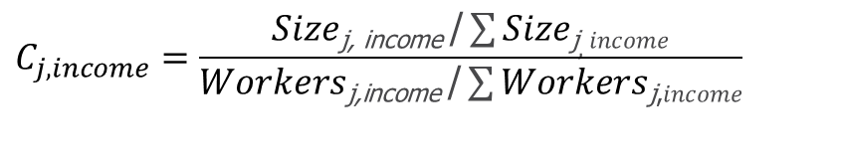
Shadow pricing in ActivitySim
In ActivitySim, work location choice size terms are segmented by income group of the worker
Employment Type | Income Group
Employment Type | Low | Medium | High | Very high
Industrial | 1.0000 | 0.2828 | 0.3528 | 0.1523
Retail | 2.3131 | 0.5745 | 0.2593 | 0.1345
Other | 2.2566 | 1.3069 | 0.8100 | 0.8100
Office | 1.0000 | 1.0000 | 1.0000 | 1.0000
The shadow prices are segmented by income group, and size terms are used instead of employment as targets:
$$C_{j, income}=\frac{Size\text{j}\text{, }\text{income} \text{/}\sum{Size\text{j}, income}}{Workers\text{j}\text{,}\text{income} \text{/}\sum{Workers\text{j}\text{,}income}}$$
Because prices converge to size term rather than employment, there is no guarantee of matching total jobs by zone.

Slide 10
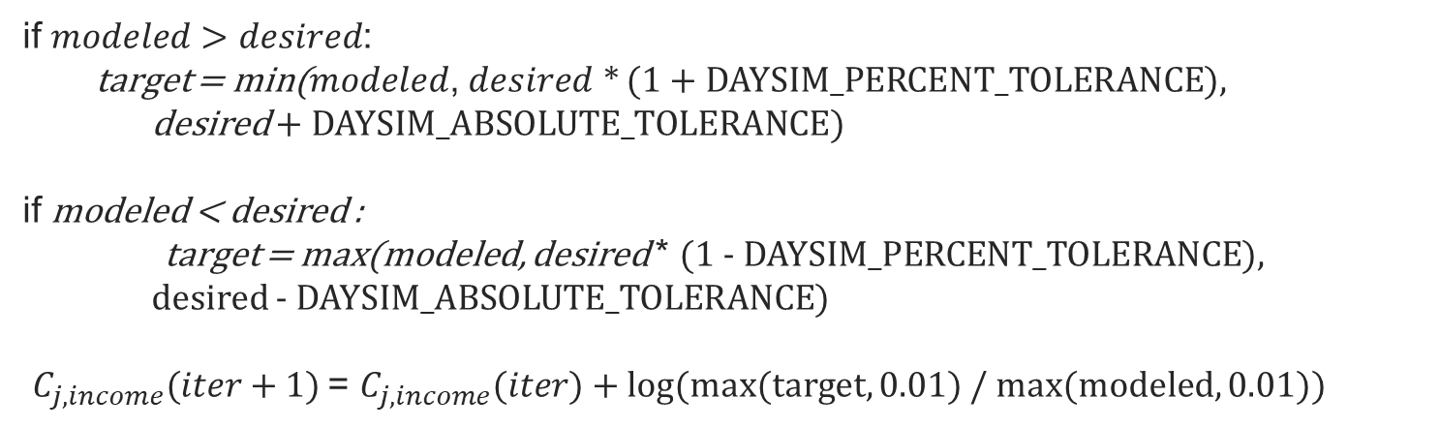
Shadow pricing in ActivitySim
There are two methods for calculating prices
SHADOW_PRICE_METHOD: ctramp
$C_{j, income}(iter+1)$= $C_{j, income}(iter)$* DAMPING_FACTOR
where: 0 < DAMPING_FACTOR < 1
SHADOW_PRICE_METHOD: daysim
if $modeled>desired$:
target = min($modeled$, $desired$ * (1 + DAYSIM_PERCENT_TOLERANCE),
desired + DAYSIM_ABSOLUTE_TOLERANCE)
if modeled < desired :
target = max(modeled, desired * (1 - DAYSIM_PERCENT_TOLERANCE),
desired - DAYSIM_ABSOLUTE_TOLERANCE)
$C_{j, income}(iter+1)$= $C_{j, income}(iter)$+ log(max(target, 0.01) / max(modeled, 0.01))
Every workers is re-simulated in every iteration, even workers who work in zones where modeled = desired!

Slide 11
Proposed Revised Approach

Slide 12
Proposed Enhancements
Calculate prices as additive terms
  Easier to interpret than multiplicative terms
  Can be calculated at different geography than zone (at TAZ level instead of MAZ level in 2-zone and 3-zone models)
Use (scaled) total employment as target for work location choice instead of scaled size term
  Desired constraint is total employment not relative size of zone
  Scaling still required to account for differences between total workers and total employment
Introduce person-level weights when calculating modeled ratios
  To account for differential population sampling when applying model for traffic impact studies
Change iteration mechanism
  To decrease runtime (next slide)

Slide 13
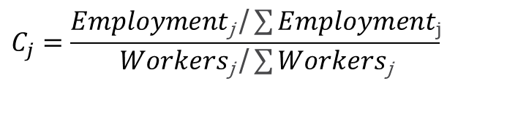
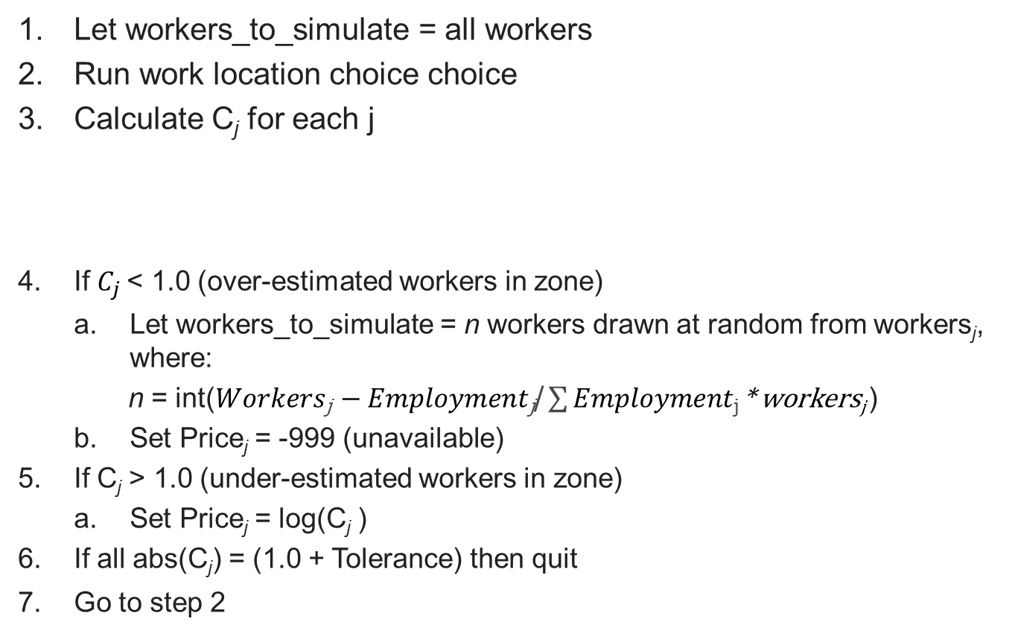
Revised iteration mechanism
Let workers_to_simulate = all workers
Run work location choice choice
Calculate C_{j} for each j
If $C_{j}$< 1.0 (over-estimated workers in zone)
  Let workers_to_simulate = n workers drawn at random from workers_{j}, where:
  n = int($Workers\text{j} −Employment\text{j}\text{/}\sum{Employment\text{j}}$* workers_{j} )
  Set Price_{j} = -999 (unavailable)
If C_{j} > 1.0 (under-estimated workers in zone)
  Set Price_{j} = log(C_{j} )
If all abs(C_{j}) = (1.0 + Tolerance) then quit
Go to step 2
$$C_{j}=\frac{Employment\text{j} \text{/}\sum{Employment\text{j}}}{Workers\text{j} \text{/}\sum{Workers\text{j}}}$$

Slide 14
Advantages
Should significantly reduce runtime for shadow pricing
  Number of workers to simulate in each iteration decreases with each iteration
Can carefully control convergence to workers per employee in each zone
Can flexibly define size of geography (groups of zones) for convergence
Results are independent of the order in which workers are simulated
Experimentation will be necessary!

Slide 15

Questions/Discussion

Slide 16
Joel Freedman
Senior Director
Joel.Freedman@rsginc.com

Slide 17
Accessibilities
Usual Work, K-12, Univ. Location
Transit Subsidy Model
Transit Pass Model
Auto Ownership
Vehicle Type Model
Free Parking Eligibility
Telecommute
Coordinated Daily Activity Pattern
Mandatory
Fully Joint
Indiv. Non-Mand.
At-Work
Frequency
Frequency
Frequency
Frequency
Composition
Participation
Scheduling
Destination
Destination
Destination
School Dropoff/Pickup
Scheduling
Scheduling
Scheduling
Vehicle Availability Model
Mode
Stop Frequency
Purpose
Aggregate
Destination
Long-Term/Mobility
Scheduling
Person Daily
Mode
Tour
Write Trip Matrices
Trip

