Slide 1


PRIVATE AND CONFIDENTIAL – EVERTEC GROUP, LLC

Slide 2


Puerto Rico’s #1 Fintech App
+2 Million
+90
+353 Million
ATH Móvil has more than 2 million registered users
More than 90 participating financial institutions. Among them two (3) top banks and 90 credit unions.
More than 353 million completed transactions in 2023
PRIVATE AND CONFIDENTIAL – EVERTEC GROUP, LLC

Slide 3

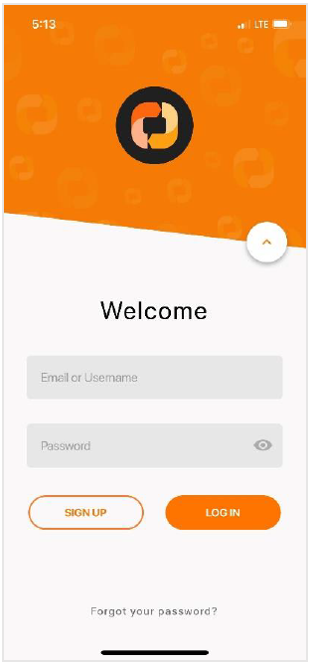

General Information
Digital platform that allows individuals to perform electronic transfers
Easy enrollment with only an email, phone number and ATH® debit card
Register up to 5 ATH® debit cards in your profile from any participating FI
All transactions happen in real-time
Completely free to download and use
View a detailed history of all transactions
Facial recognition, fingerprint or 4-digit passcode to log-in
PRIVATE AND CONFIDENTIAL – EVERTEC GROUP, LLC

Slide 4


Channels
Android App
iOS App
ATH Móvil can be used on Android devices by downloading from the Google App Store.
ATH Móvil can be used on iOS devices by downloading from the app Store.
PRIVATE AND CONFIDENTIAL – EVERTEC GROUP, LLC
Notes:
Minimum iOS 13 & Android 6 (feb 2022)
Solo disponible en dispositivos móviles. No Web

Slide 5




Authentication
E-mail & Password
Fingerprint
4-Digit
Passcode
Facial Recognition
Users can log-in to their ATH Móvil account through different methods:
PRIVATE AND CONFIDENTIAL – EVERTEC GROUP, LLC
Notes:
El passcode es unico de la aplicación de ATHM. No tiene que ser el del dispositivo movil.

Slide 6




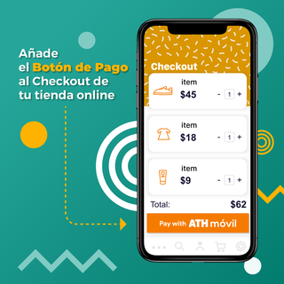
Transaction Types
Users can do different transactions through ATH Móvil:
Send Money to Persons
Pay a Business
Transfer between Cards
Donate
eCommerce
QR Code Payments
PRIVATE AND CONFIDENTIAL – EVERTEC GROUP, LLC

Slide 7

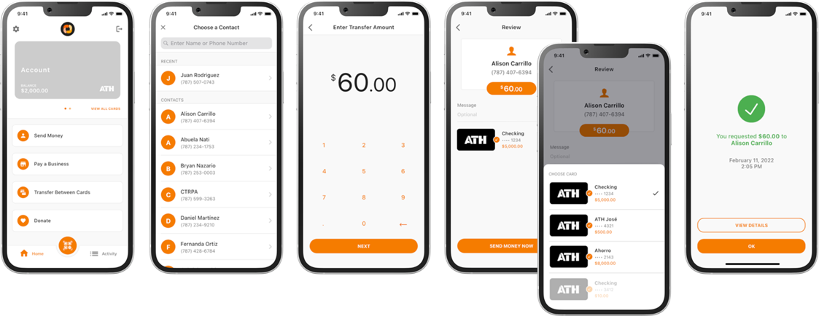
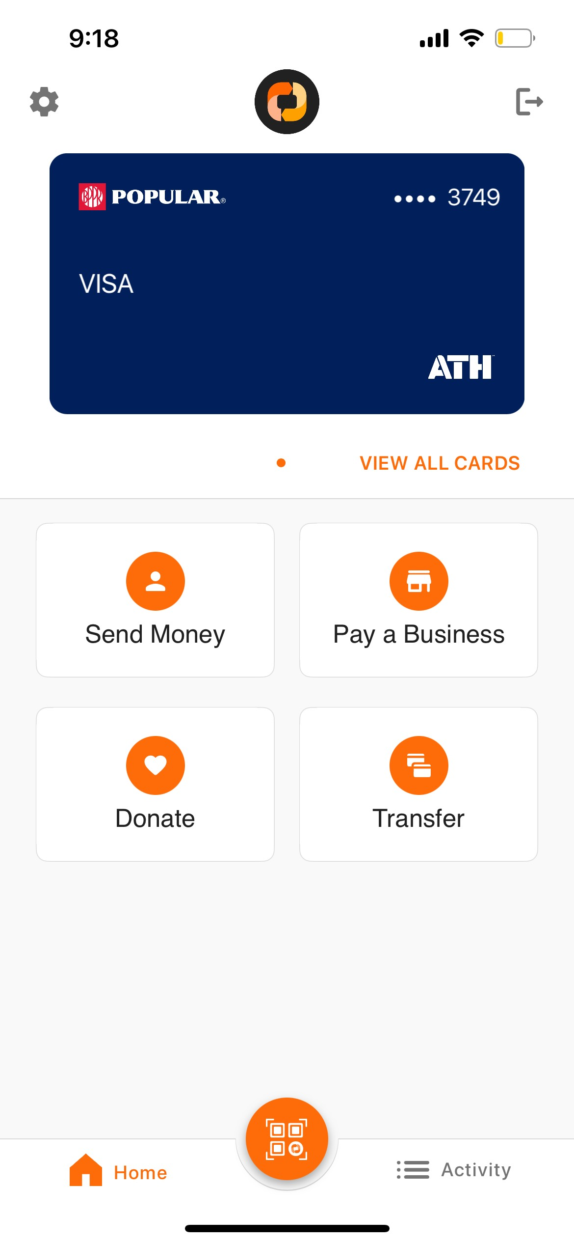


P2P Transactions
Select ‘Send Money to a Person’ button
Search and choose contact from contacts in phone or enter phone number
Enter transfer amount
Min: $1.00
Max: $500.00
Review transfer, enter optional message and choose card to send money from
Done!
PRIVATE AND CONFIDENTIAL – EVERTEC GROUP, LLC

Slide 8
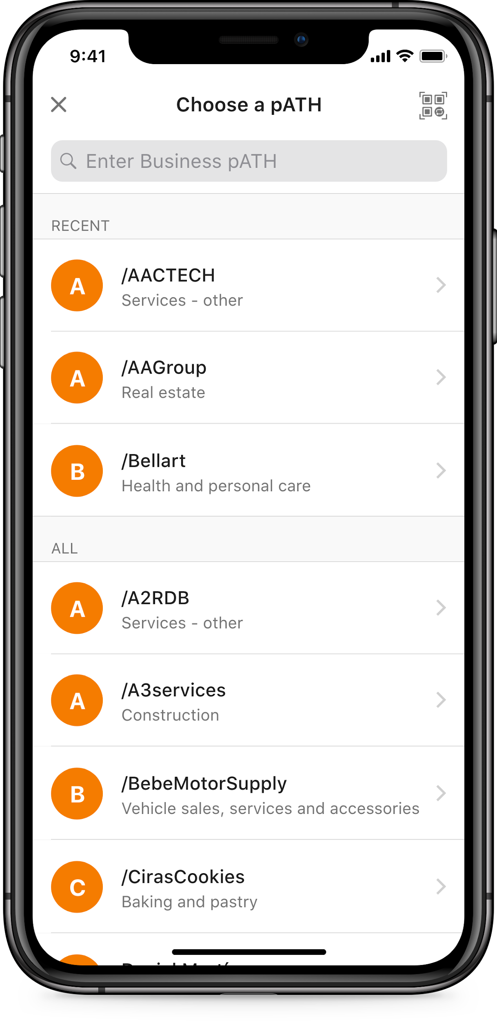
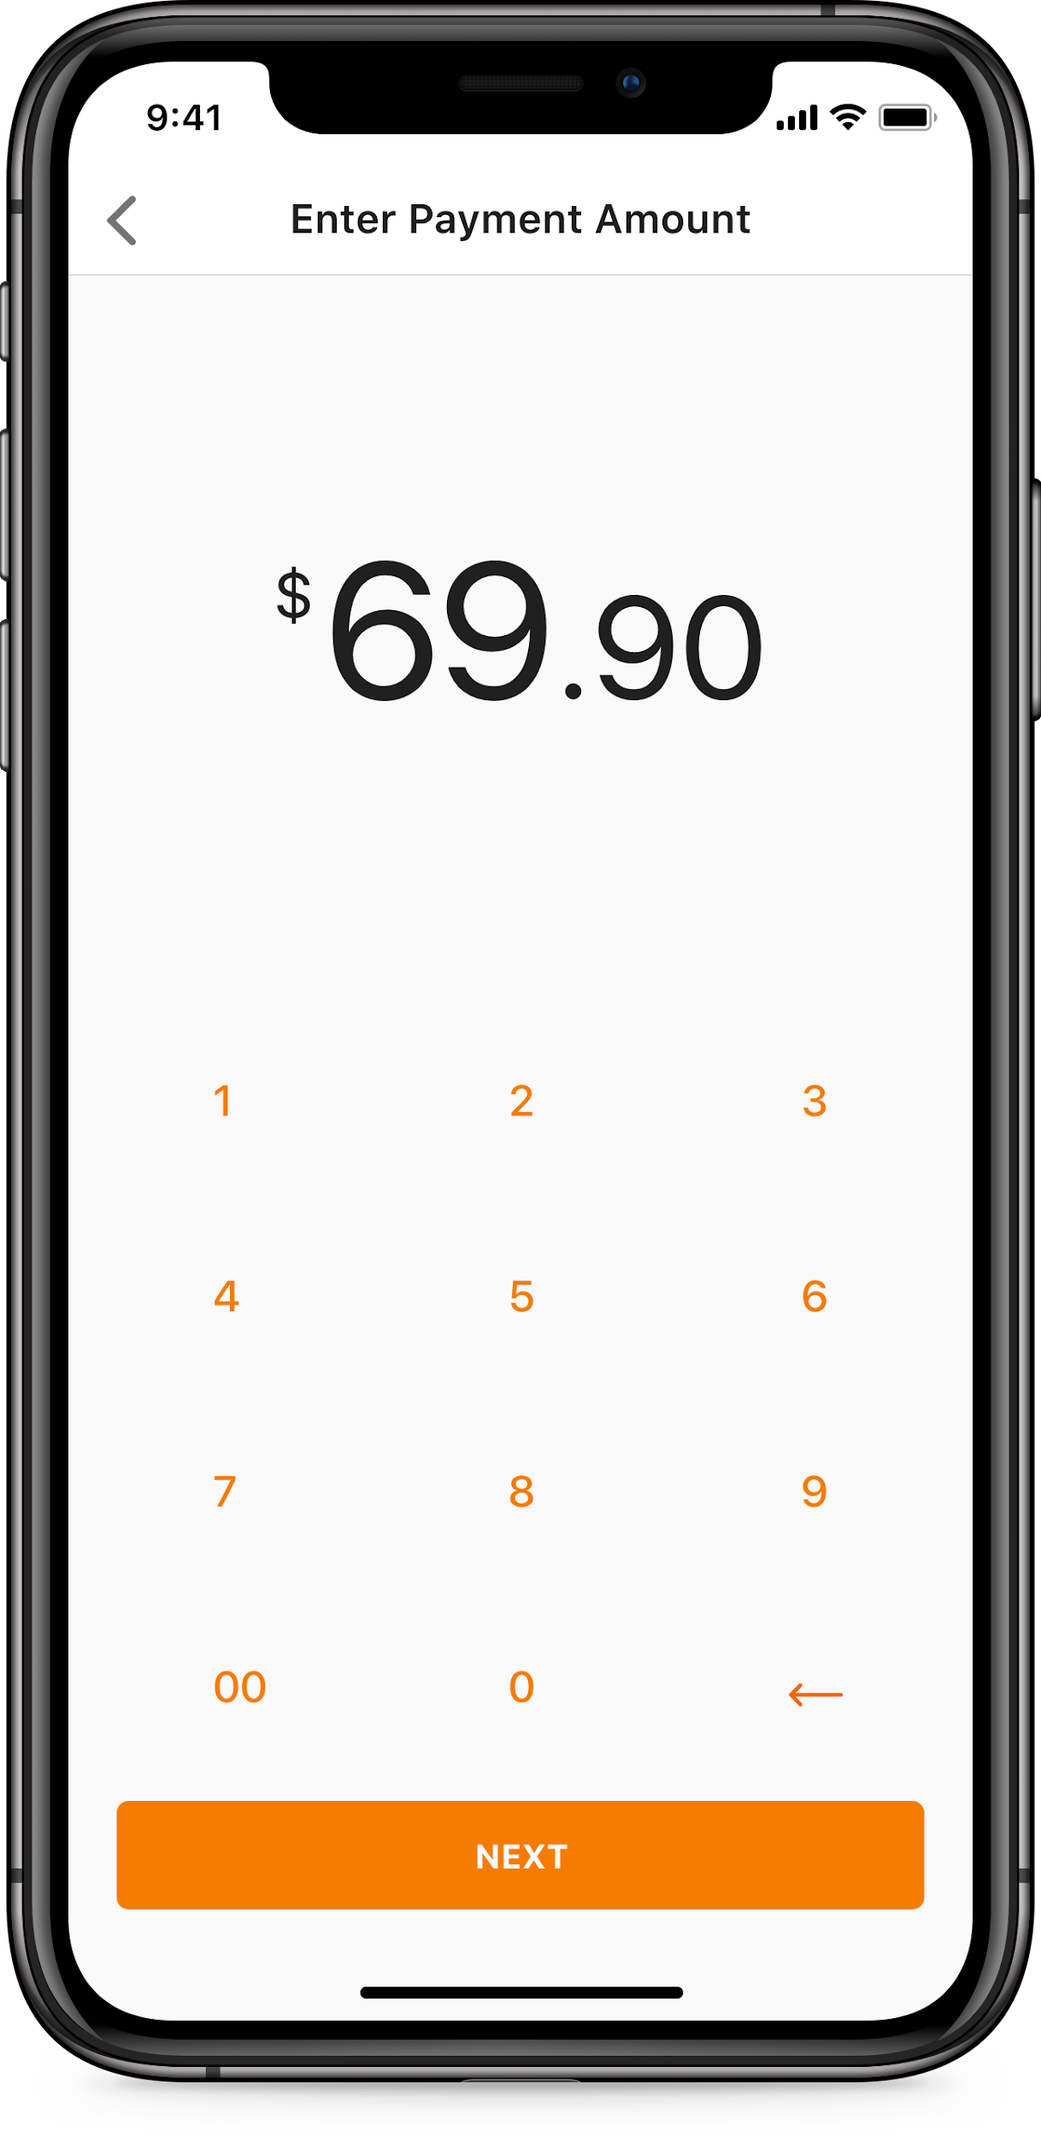
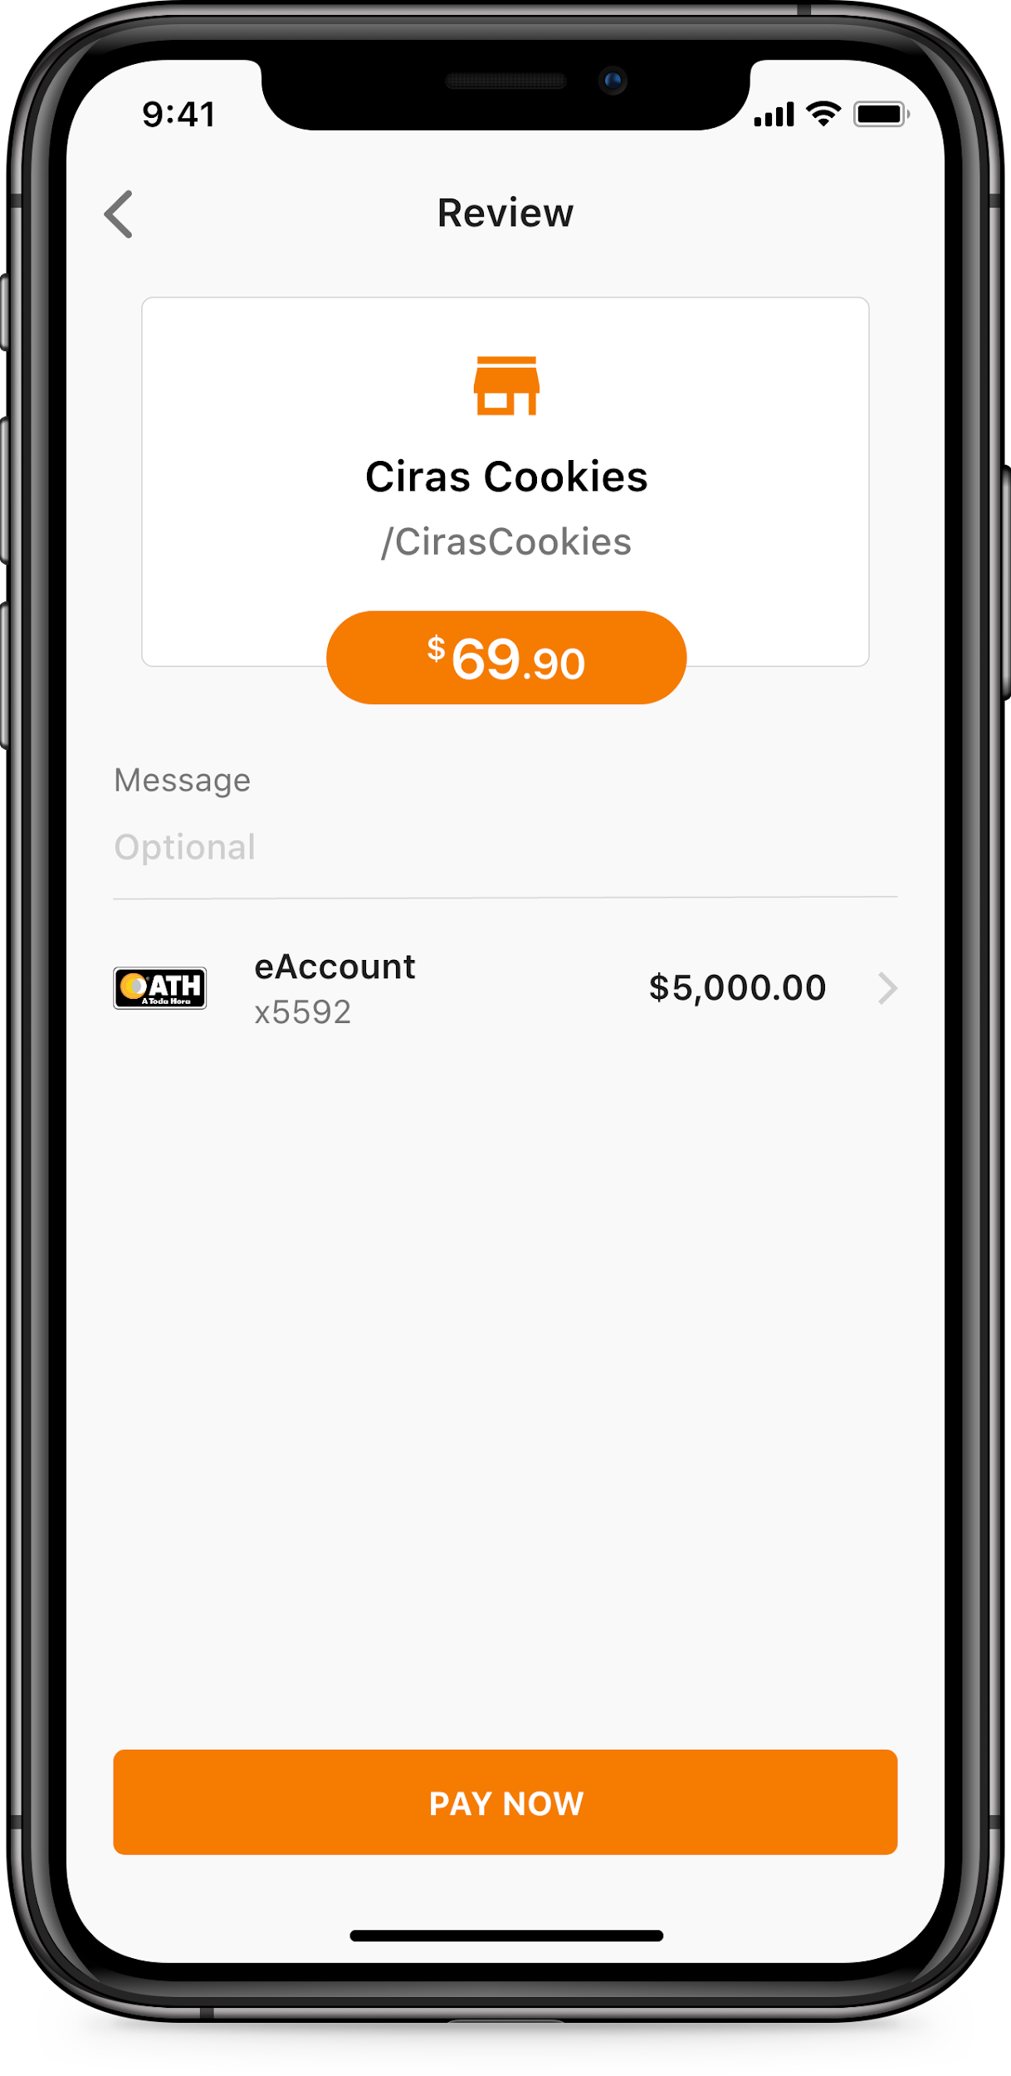
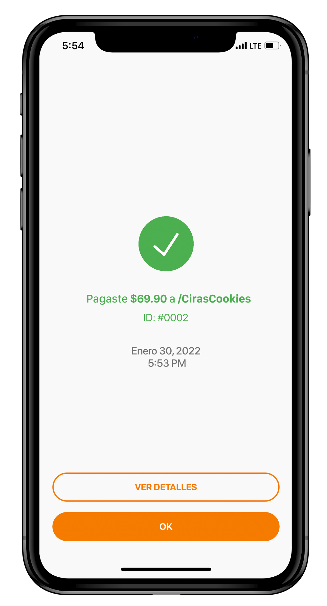
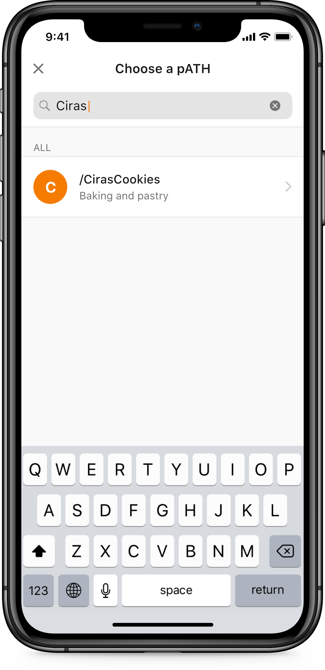
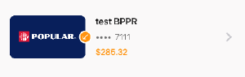
Pay Businesses
NEXT
PAY NOW
Select ‘Pay a Business’ button
Search for pATH or choose pATH from recent list
Enter payment amount
Min: $1.00
Max: $1,500
Review payment and enter optional message
Done!
PRIVATE AND CONFIDENTIAL – EVERTEC GROUP, LLC

Slide 9
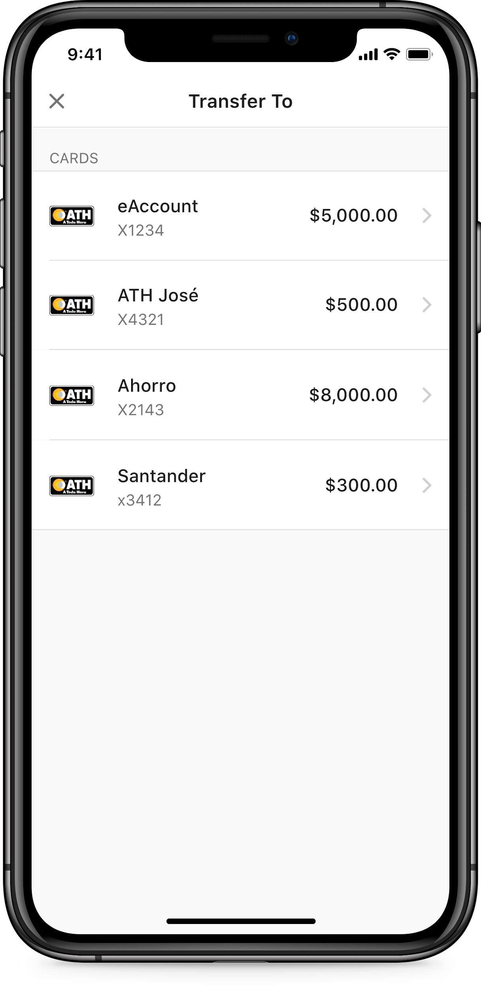
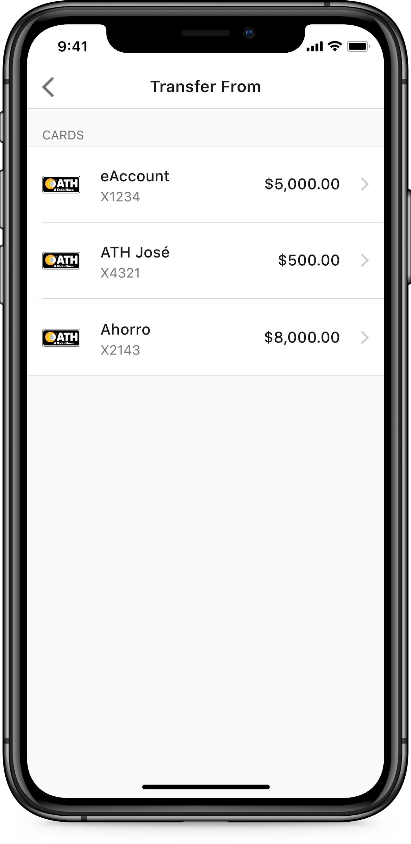
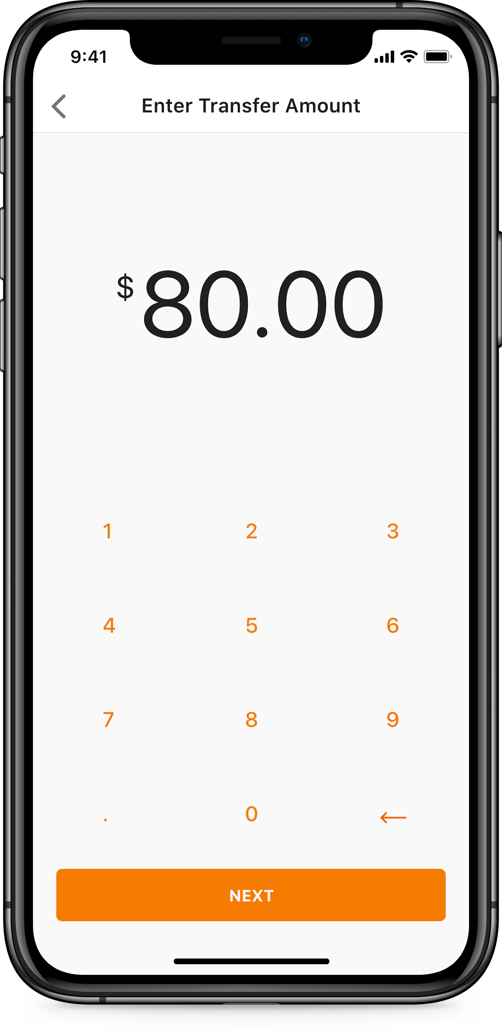
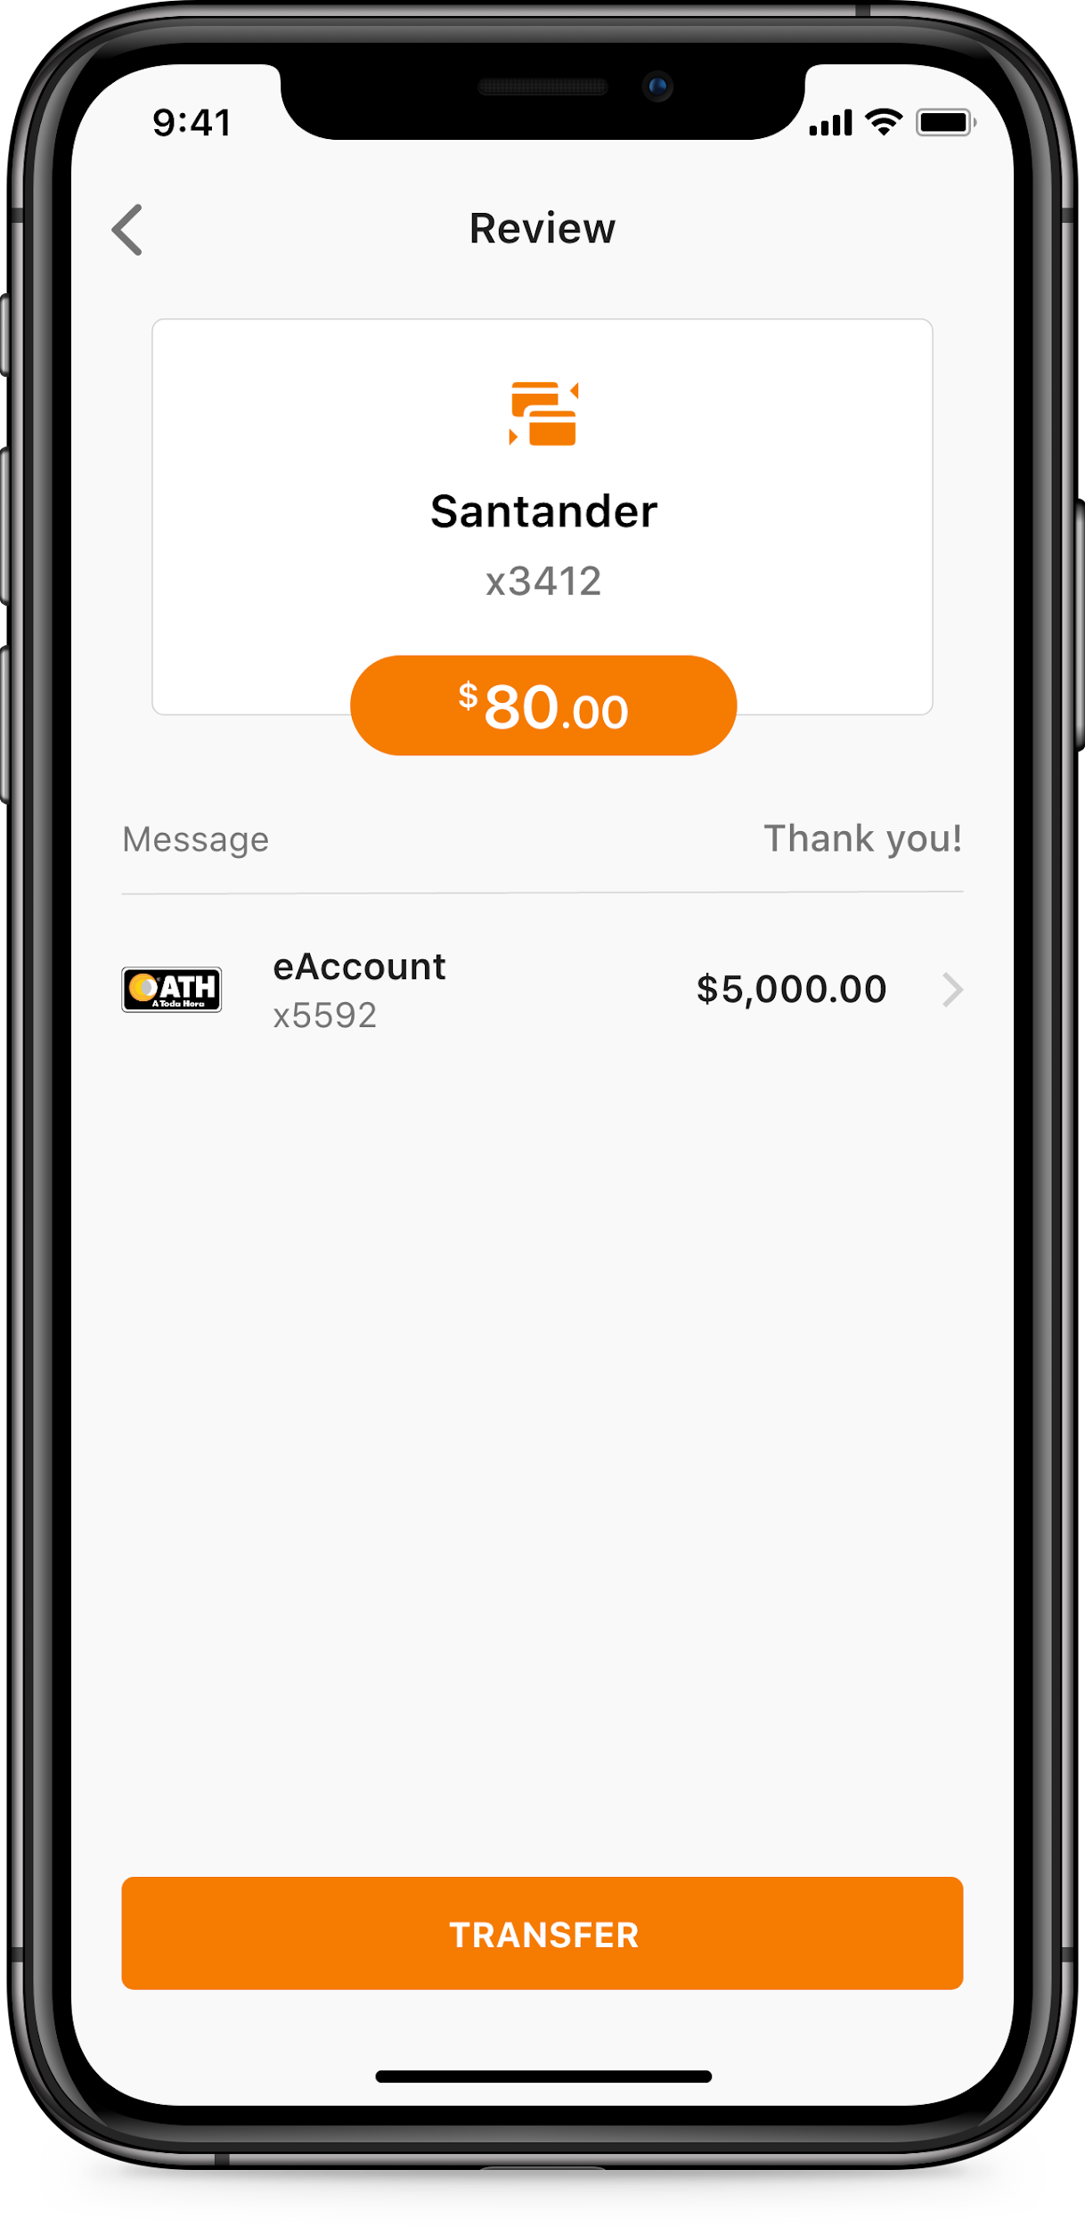
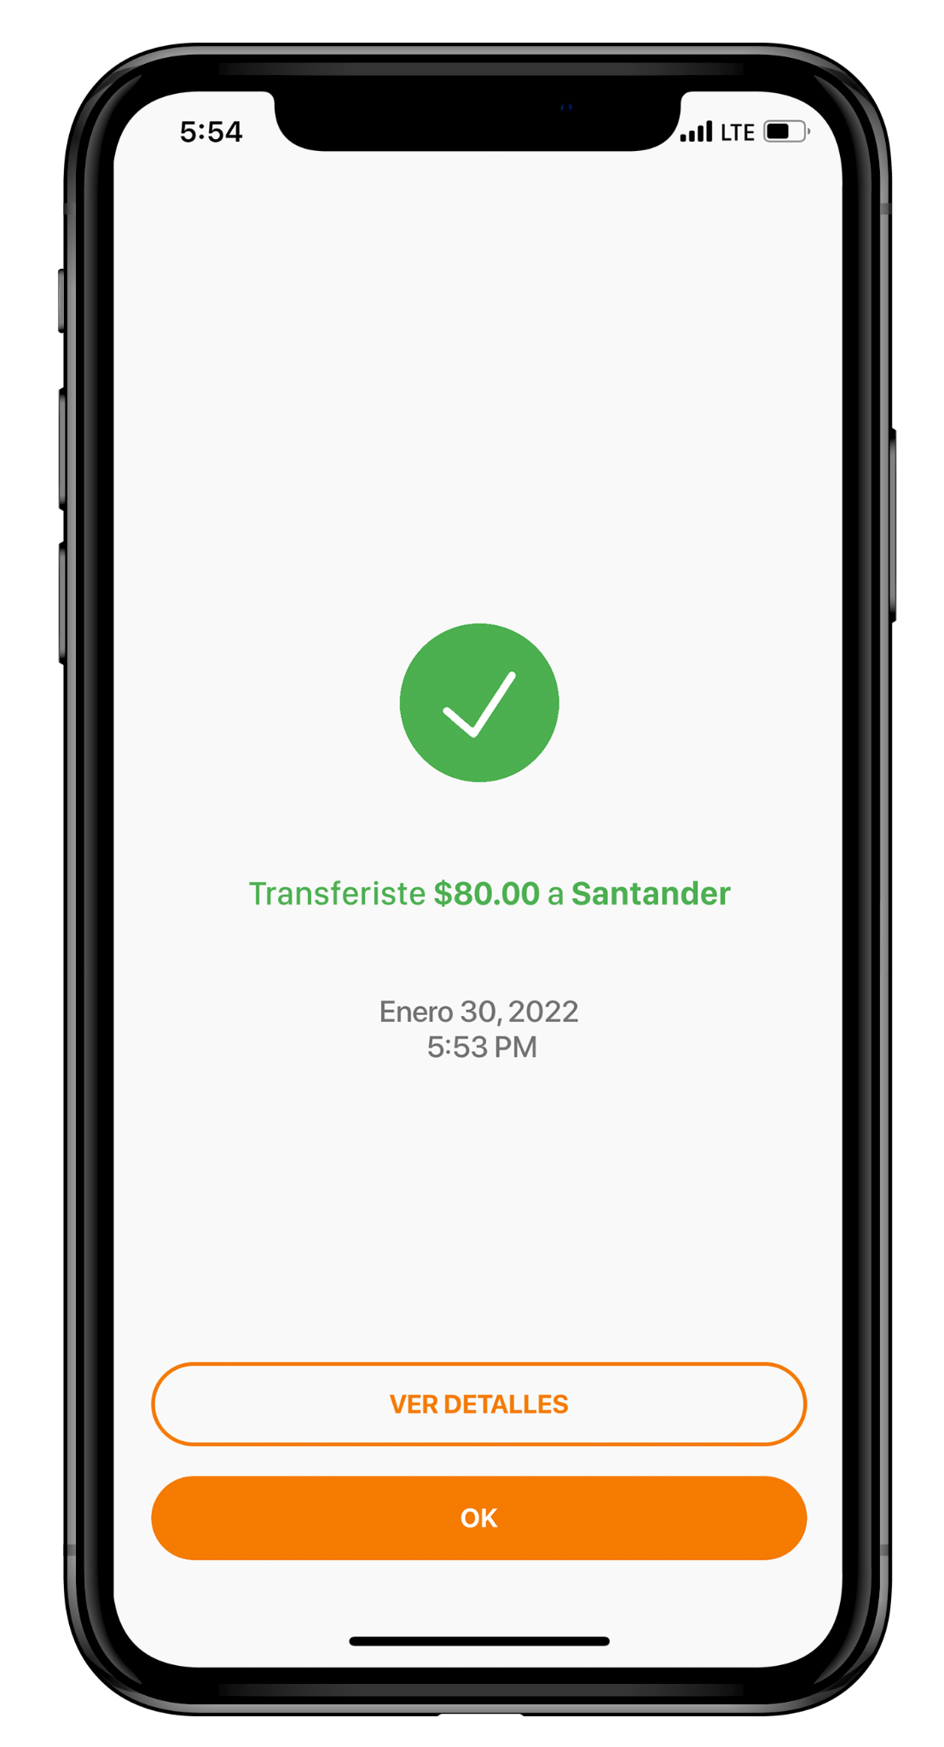
Transfer Between Cards
NEXT
TRANSFER
Select ‘Transfer Between my Cards’ button
Choose card to transfer money to
Choose card to transfer money from
Enter transfer amount
Min: $1.00
Max: $500.00
Review and complete transfer
Done!
PRIVATE AND CONFIDENTIAL – EVERTEC GROUP, LLC

Slide 10
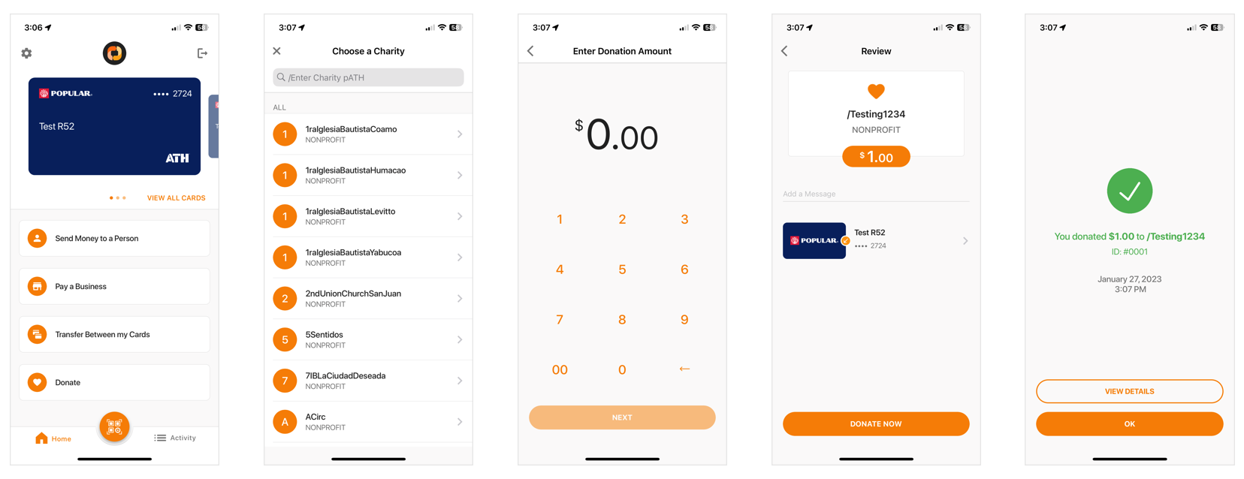

Donations
Select ‘Donate’ button
Search and choose non-profit organization’s pATH from list
Enter donation amount
Min: $1.00
Max: $1,500
Review and complete donation
Done!
PRIVATE AND CONFIDENTIAL – EVERTEC GROUP, LLC
Notes:
Browser will prompt user to return to ATH Móvil app

Slide 11

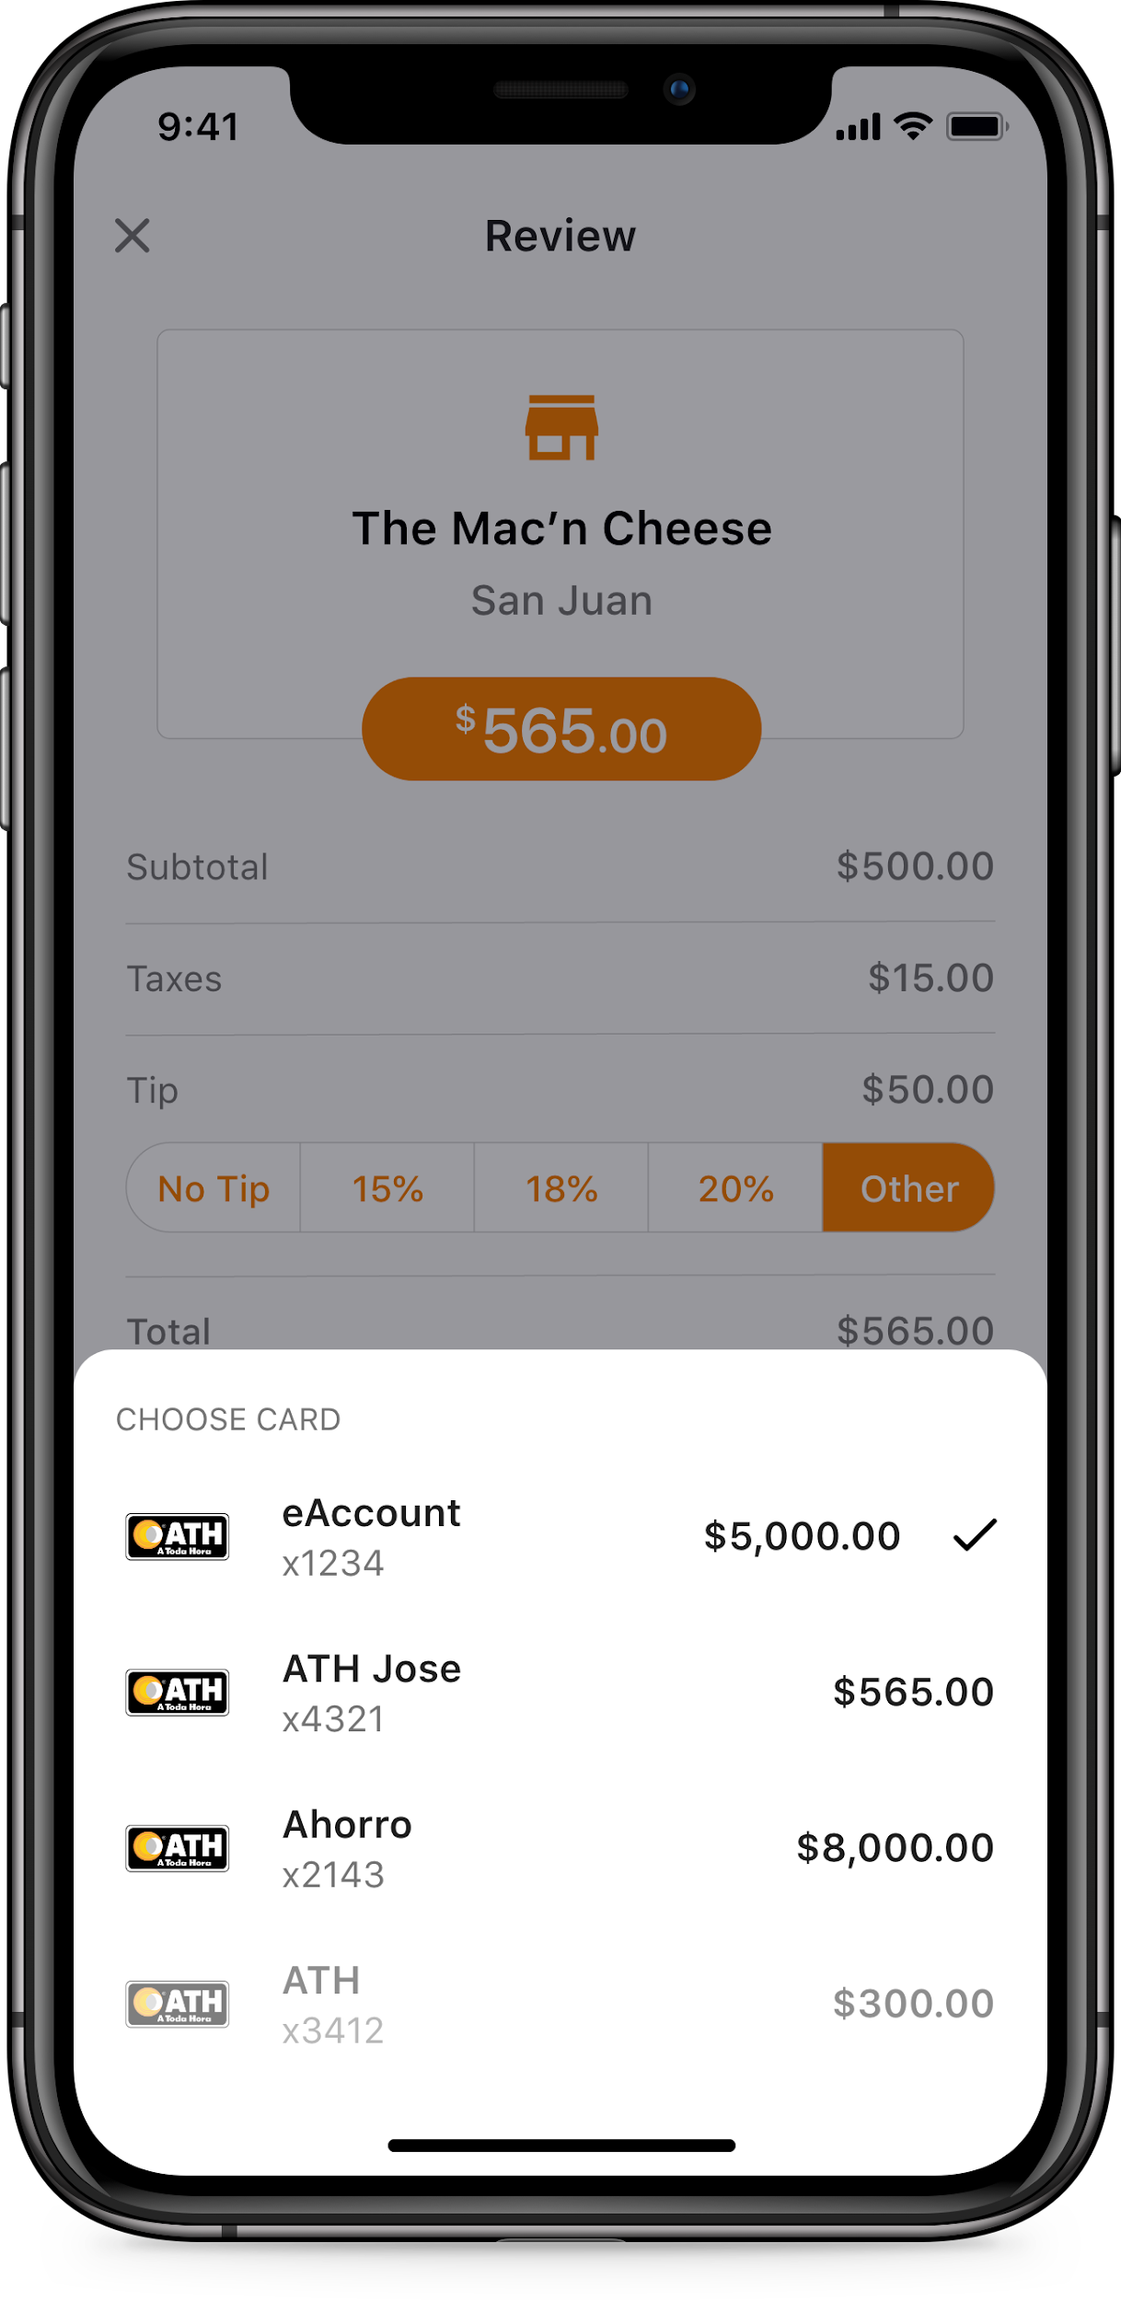
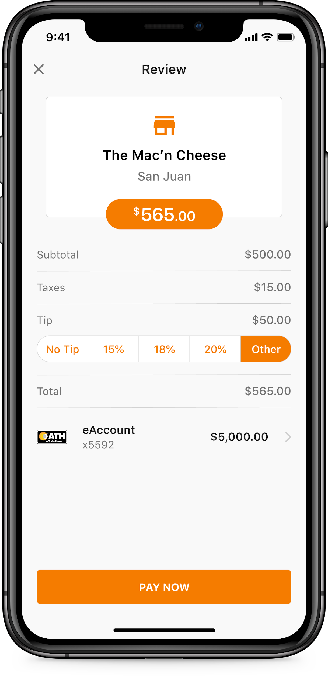
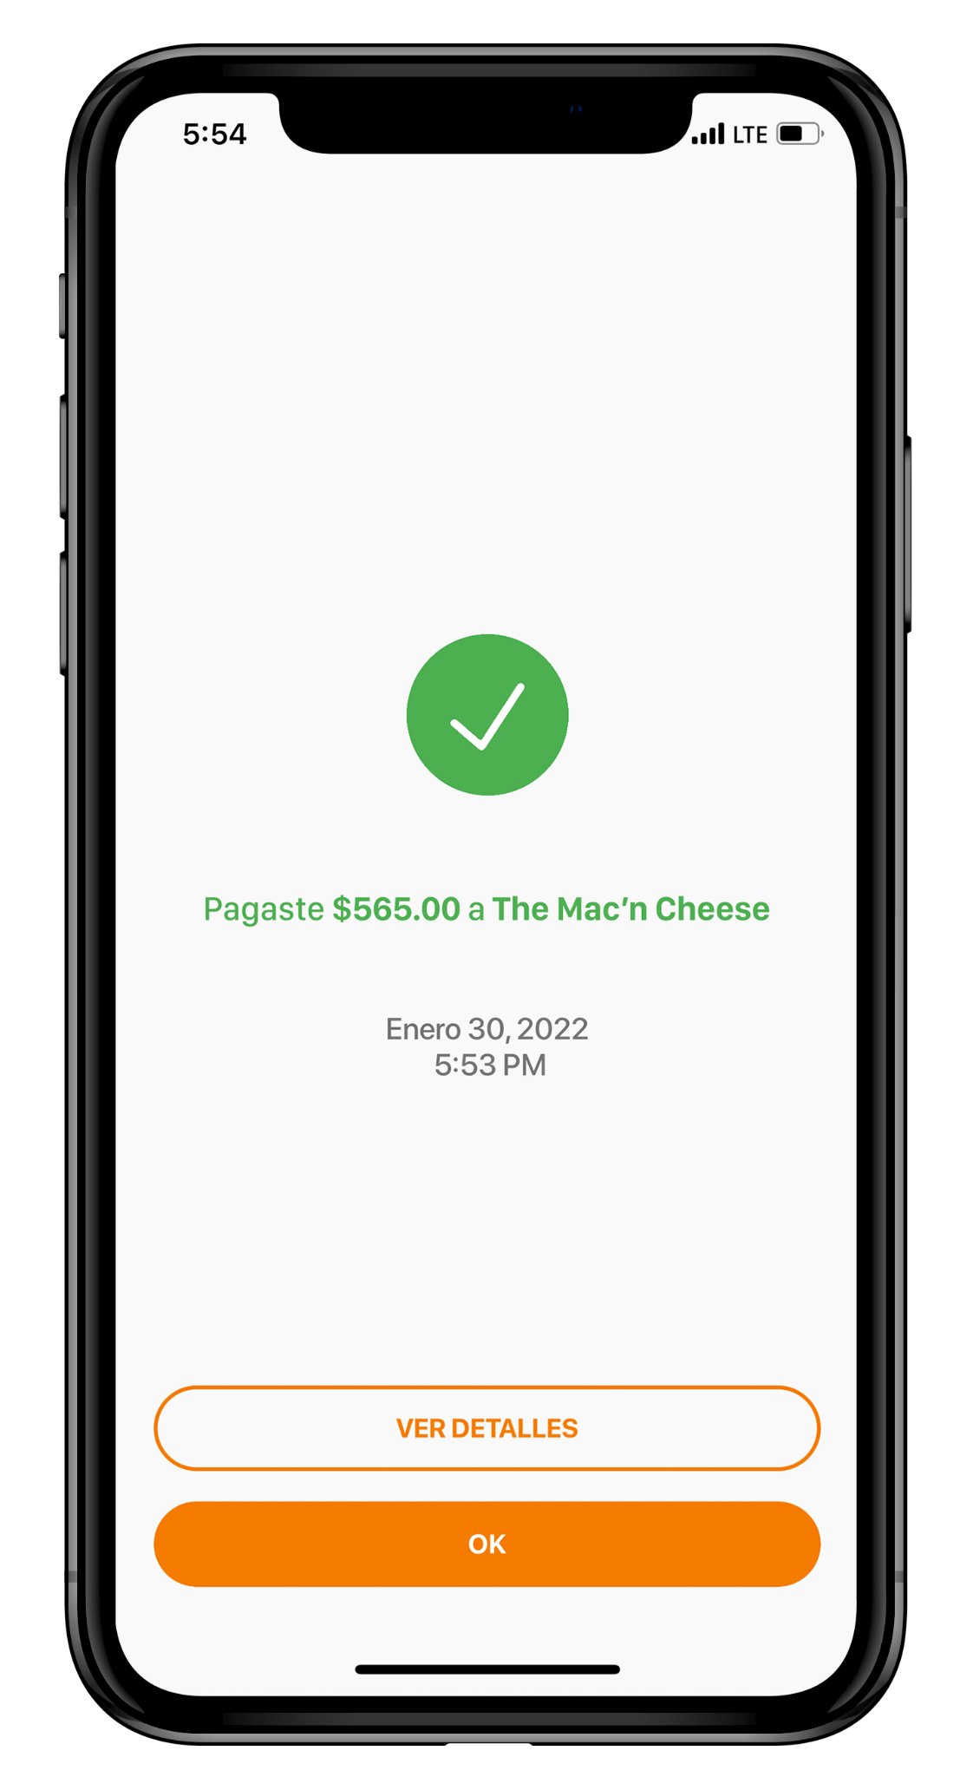
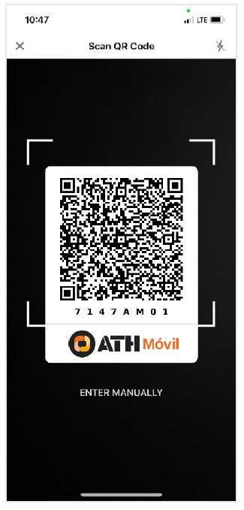
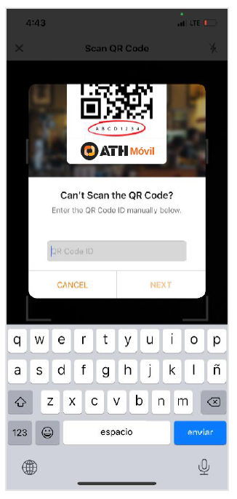
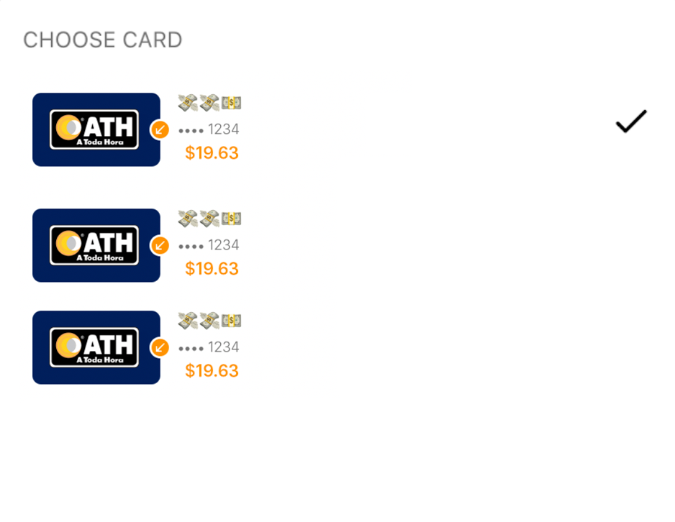
QR Code Payments
PAY NOW
Scan ATH Móvil QR code at participating merchants
Select ‘QR’ button
Enter manually if having trouble scanning
Review payment and add tip (if available)
Done!
PRIVATE AND CONFIDENTIAL – EVERTEC GROUP, LLC
Notes:
Tambien existe QR Code del pATH que lleva directo al pATH sin tener que buscarlo. El cliente solo entra la cantidad a pagar al ATH Business, confirma y listo.

Slide 12


E-Commerce
Pay with ATH Móvil at hundreds of local online businesses
Pay securely without entering card information
Easiest way of paying online in apps and websites
All payments done in real-time
Use any of the registered cards in ATH Móvil to pay
Daily limit of $1,500 for payments
PRIVATE AND CONFIDENTIAL – EVERTEC GROUP, LLC
Notes:
Hay comercios en ATH Business que han integrado el boton de pago a su app o pagina web para aceptar pagos por ATHM.

Slide 13

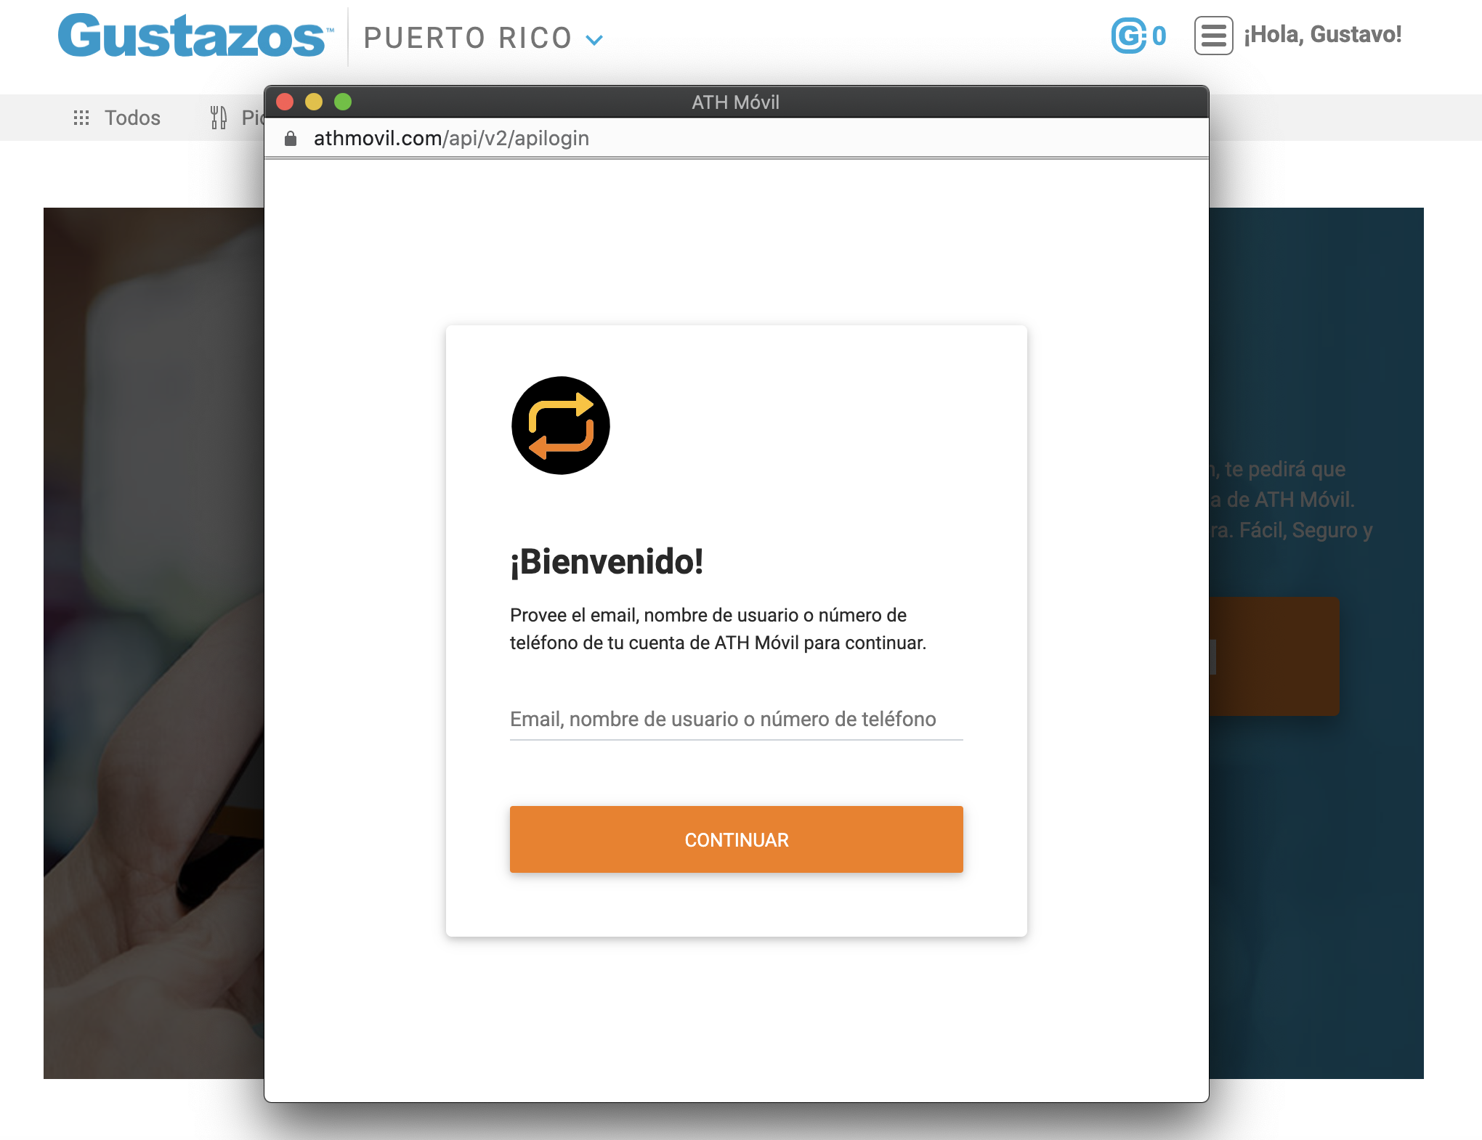
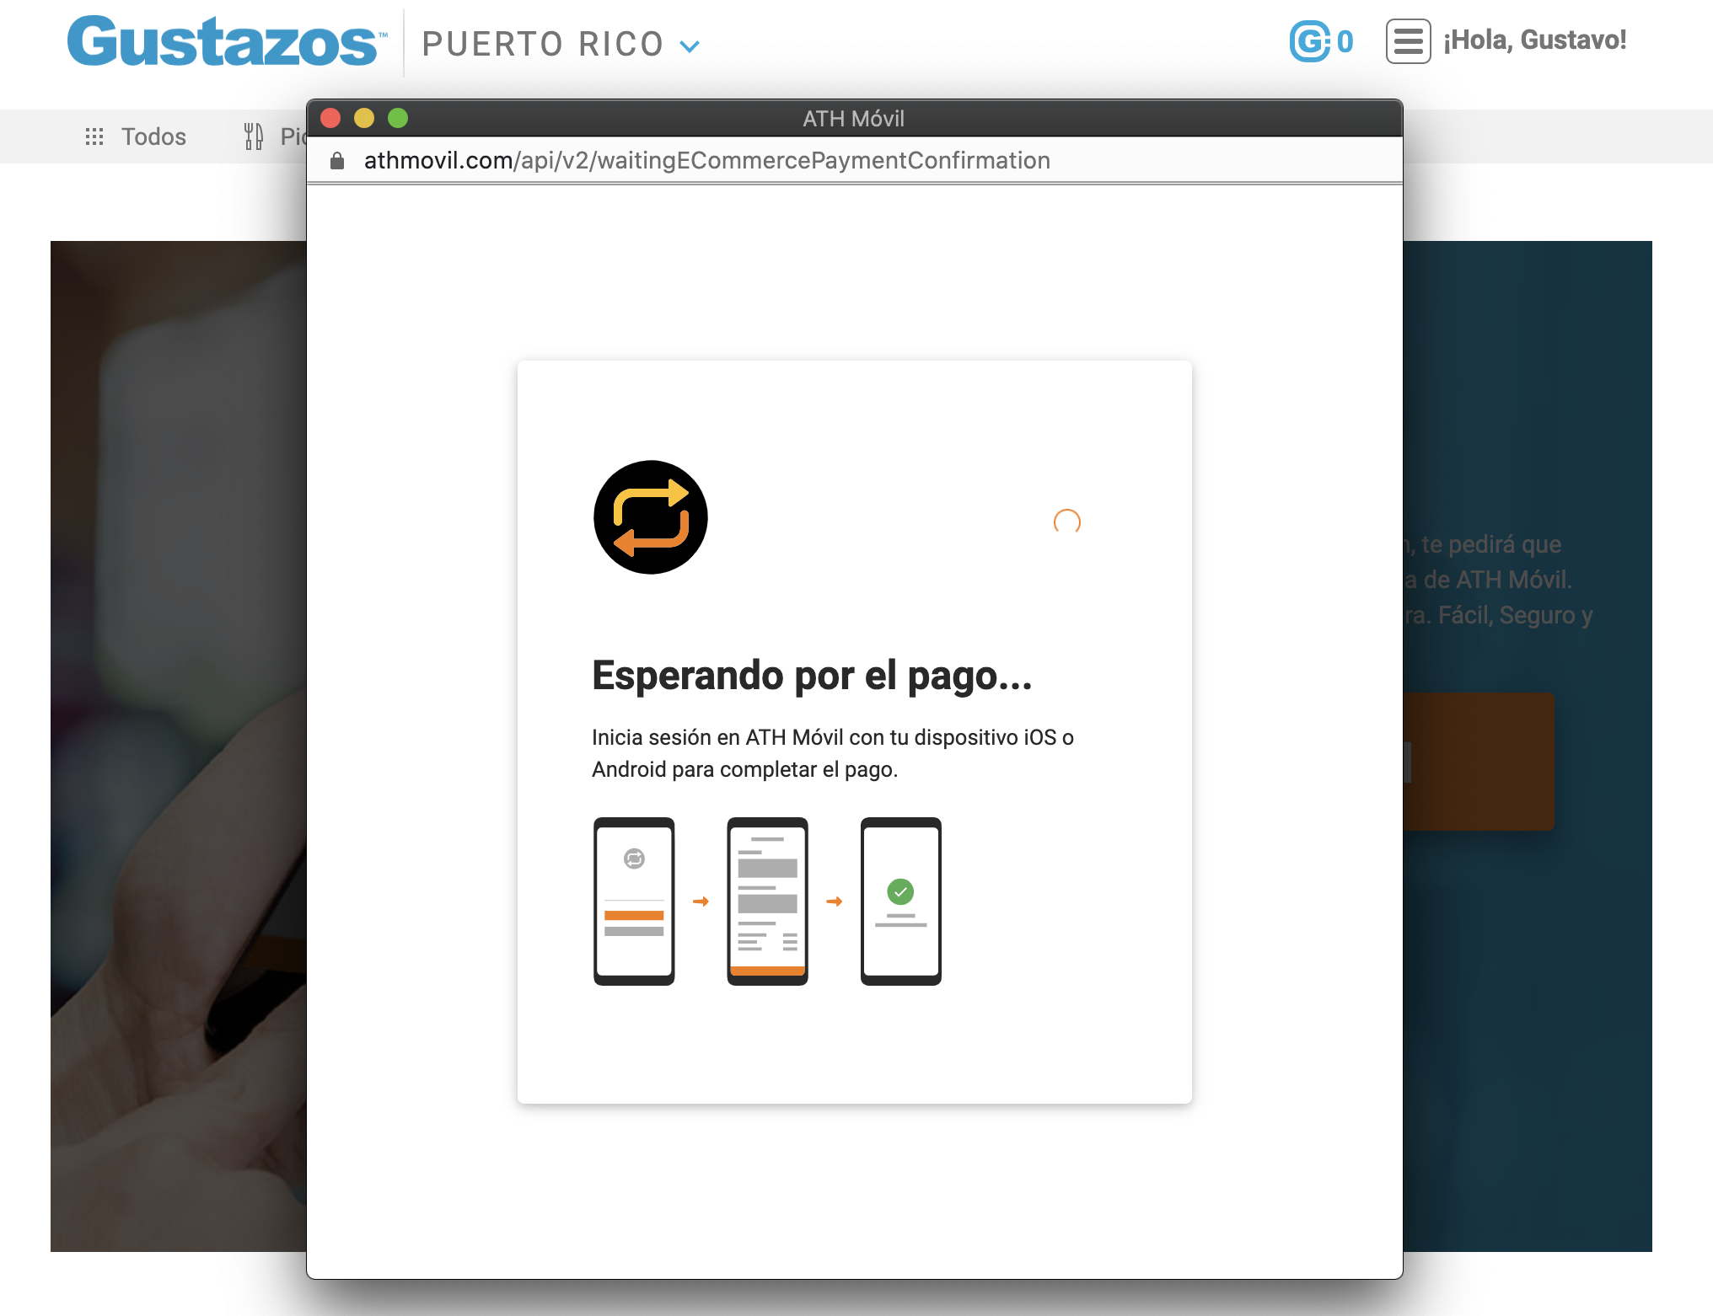
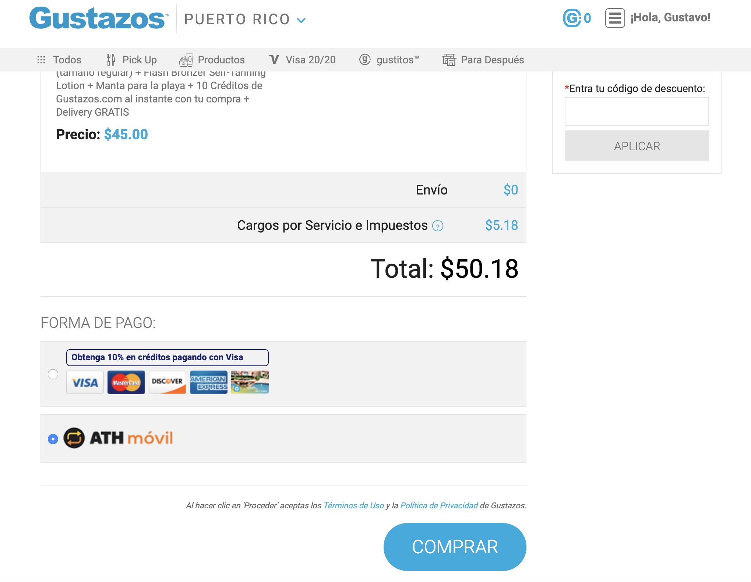
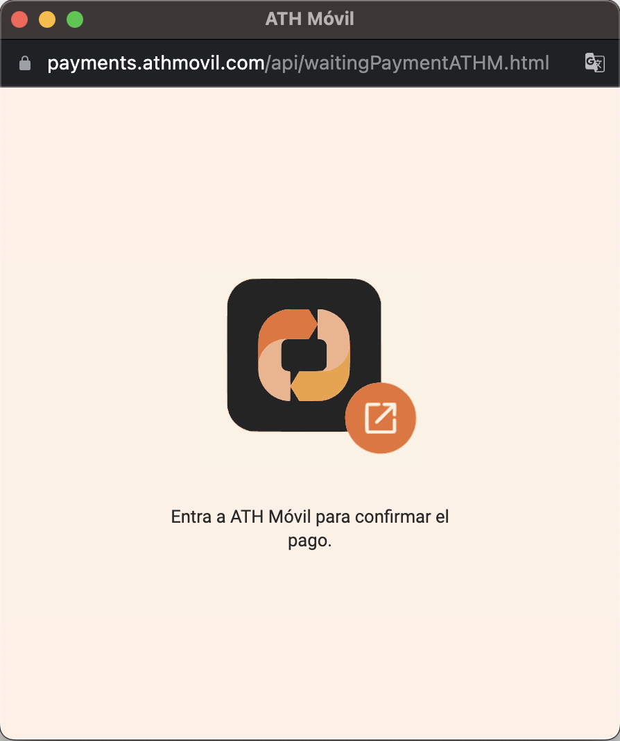
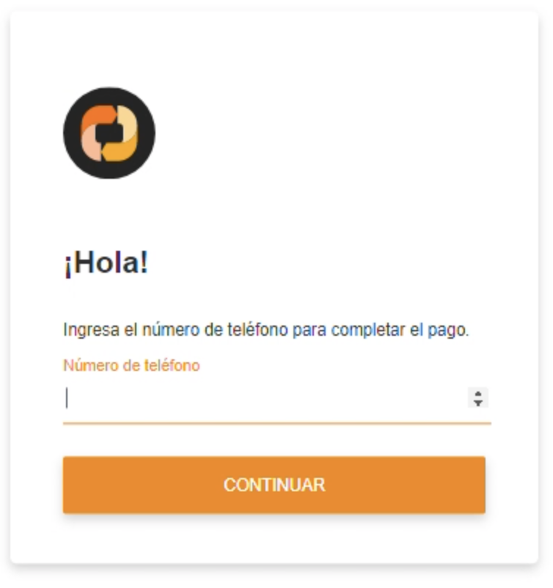
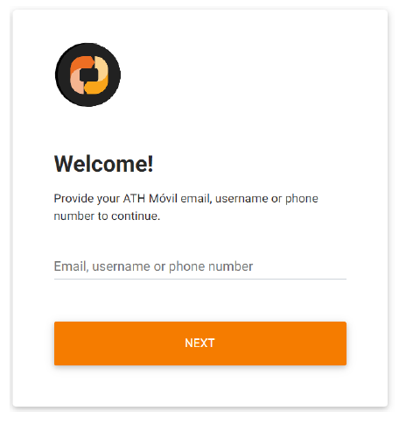


E-Commerce | Websites
Provide phone number registered in ATH Móvil to continue
Push notification is sent to user’s mobile device to complete payment
Select ‘Pay with ATH Móvil’ button on merchant’s website
PRIVATE AND CONFIDENTIAL – EVERTEC GROUP, LLC

Slide 14
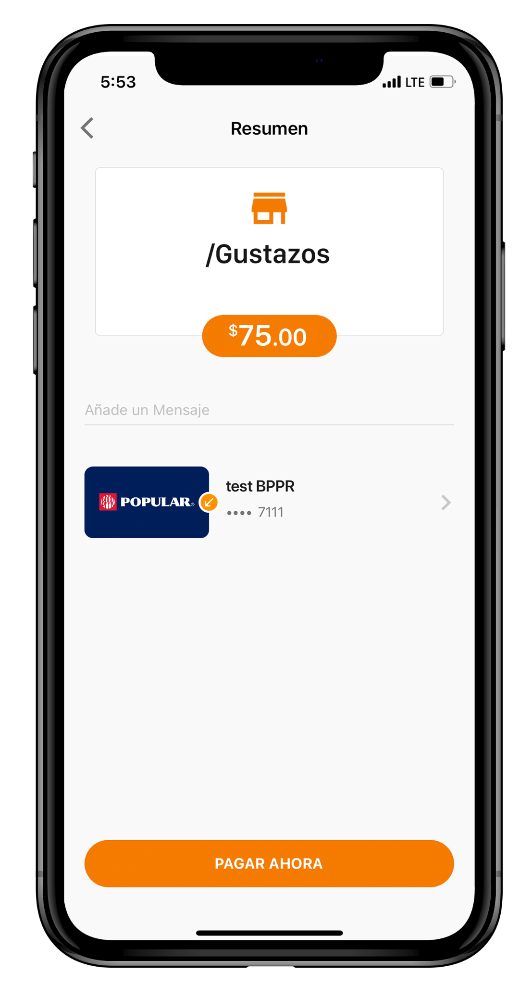

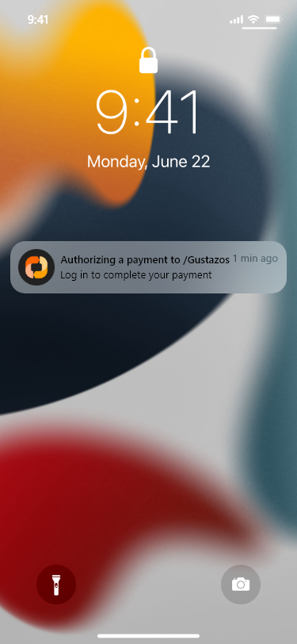
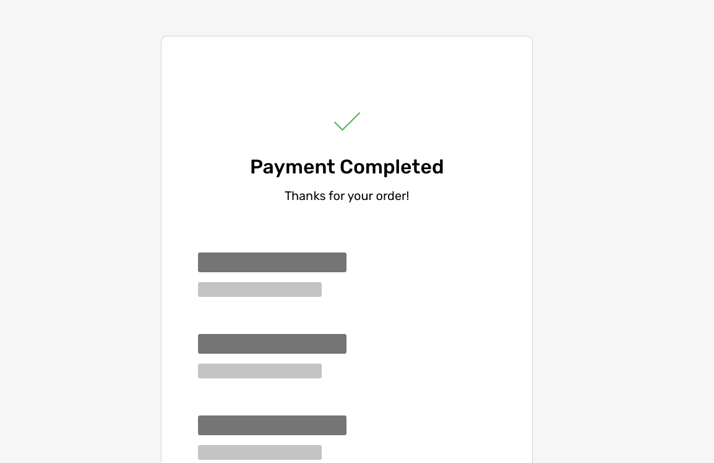
E-Commerce | Websites (continuation)
Merchant’s website will update with confirmation page and receipt
Press push notification or go to ATH Móvil app to continue
Log-in to ATH Móvil, review payment and press ‘Pay Now’
Done!
PRIVATE AND CONFIDENTIAL – EVERTEC GROUP, LLC

Slide 15
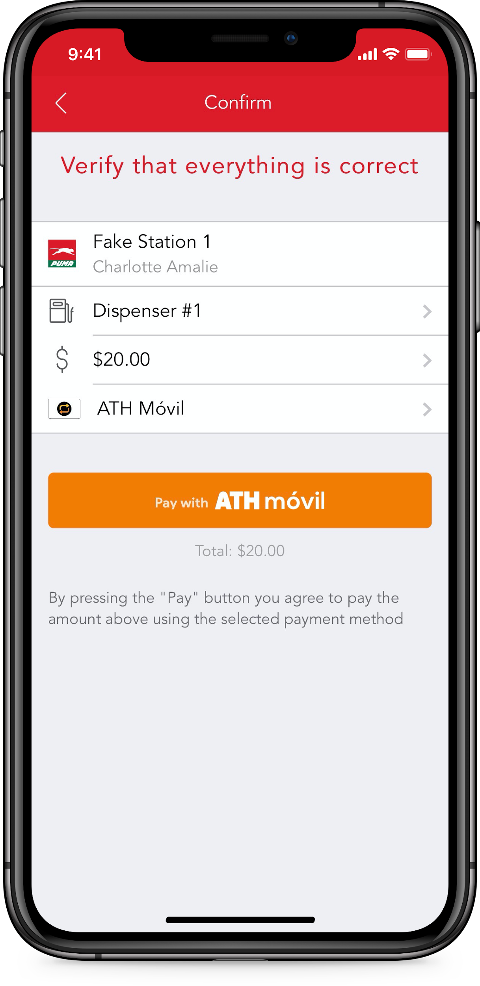
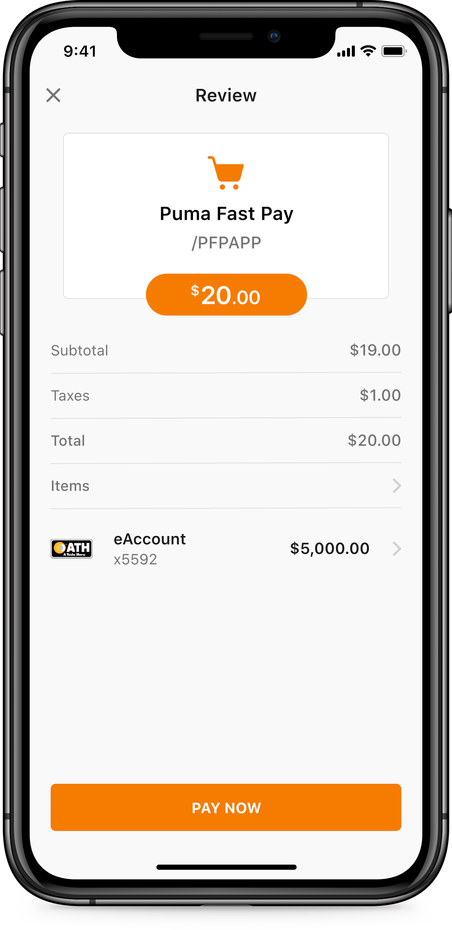
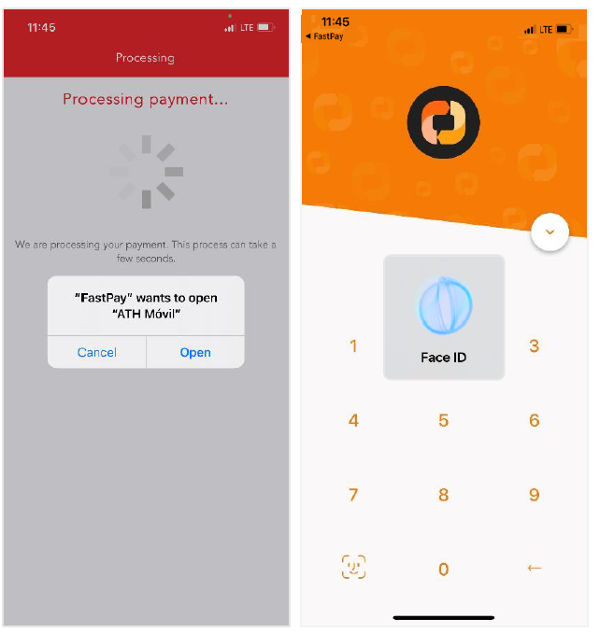
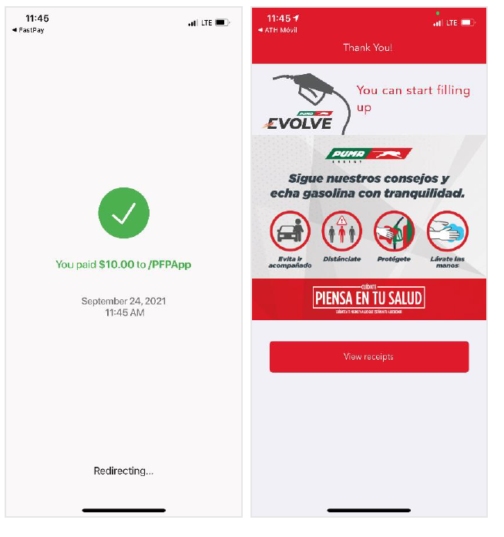
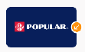
E-Commerce | Mobile App
MERCHANT’S APP
PAY NOW
Select ‘Pay with ATH Móvil’ button on merchant’s mobile app
Merchant’s app will redirect user to ATH Móvil app to complete payment
Log-in to ATH Móvil, review payment and press ‘Pay Now’
Done!
Merchant’s app will present payment confirmation
PRIVATE AND CONFIDENTIAL – EVERTEC GROUP, LLC

Slide 16

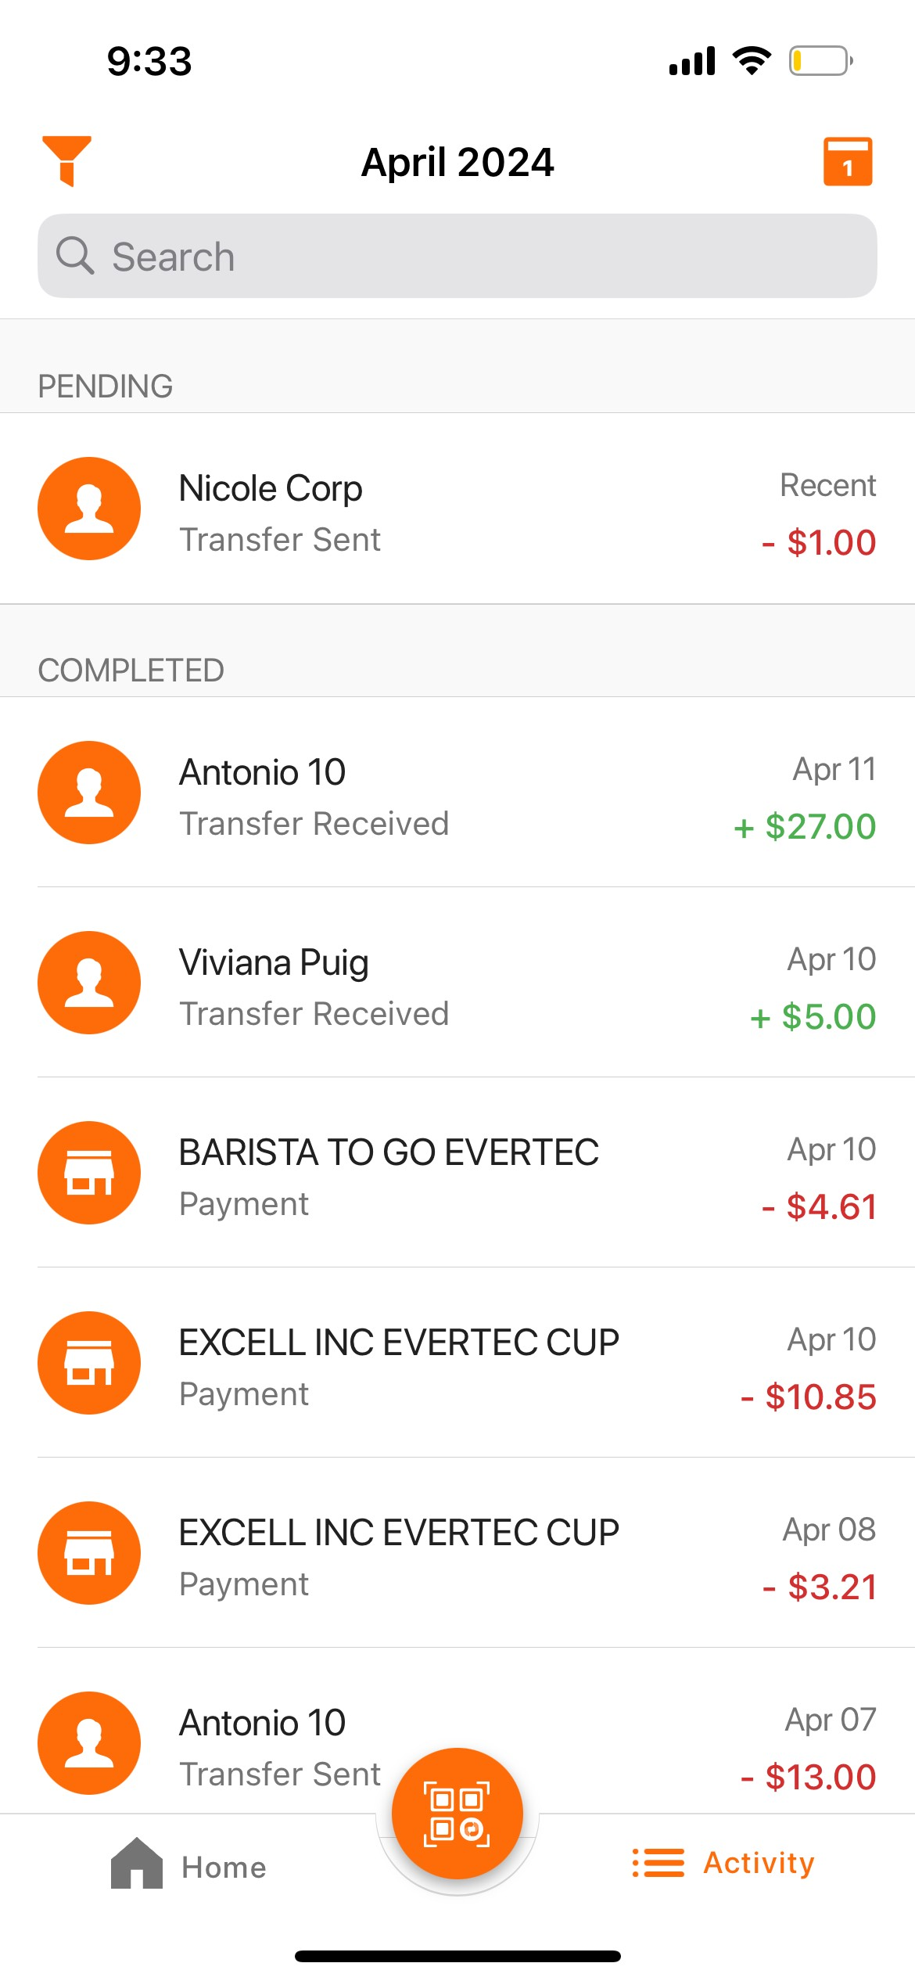
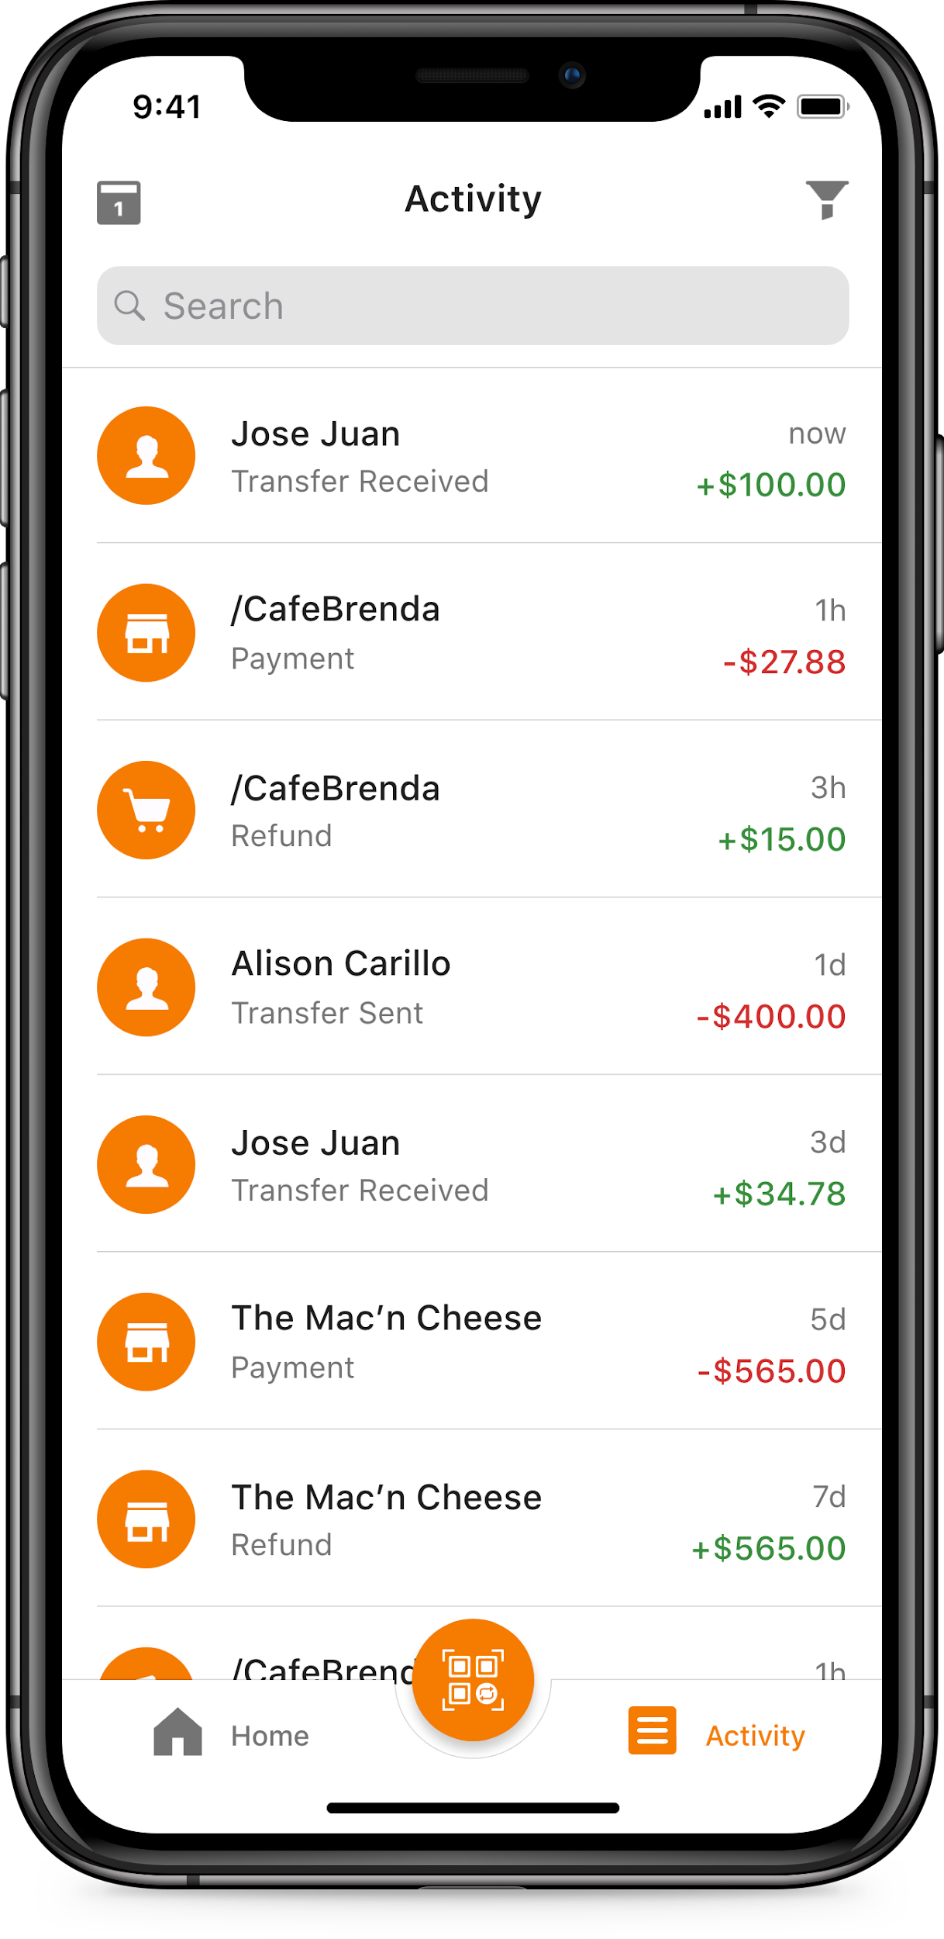


Activity
Date Filter
(View transactions from a specific month)
Transaction Type Filter
(Filter transactions by type: all, sent, received)
Transaction Icons
P2P Transfers
Transfers between cards
Payments to businesses through pATH or QR Code
Payments to businesses through Payment Button
Donations
Date Summary
(Date or hours/days since transaction was made)
PRIVATE AND CONFIDENTIAL – EVERTEC GROUP, LLC

Slide 17


Other Information
Settings
Notifications
Users can change several information from their account and configure several settings:
Change Passcode, Password, Email or Phone Number
Turn On/Off fingerprint or facial recognition
View & Manage Authorized Devices
Turn On/Off push notifications
Change Notification Language (English or Spanish)
Change Theme
Hide Balances
View Terms and Conditions and Privacy Policy
View FAQs (frequently asked questions)
Email notifications always sent for all transactions
Push notifications are optional (user’s decision)

Slide 18
PRIVATE AND CONFIDENTIAL – EVERTEC GROUP, LLC
Thank you!
athmovil.com

